Slide 1
Victory for the GRE® Test PowerPoint Table of Contents
Verbal Reasoning: Completions
Verbal Reasoning: Reading
Quantitative Reasoning: Discrete Quantitative
Quantitative Reasoning: Numeric Entry
Quantitative Reasoning: Comparisons
Quantitative Reasoning: Data Interpretation
Analytical Writing

Slide 2
Verbal Reasoning: Completions Test Mechanics
21 • Verbal Reasoning: Completions
↖ Back to the Table of Contents
Notes:
Teacher’s Guide p. 49

Slide 3
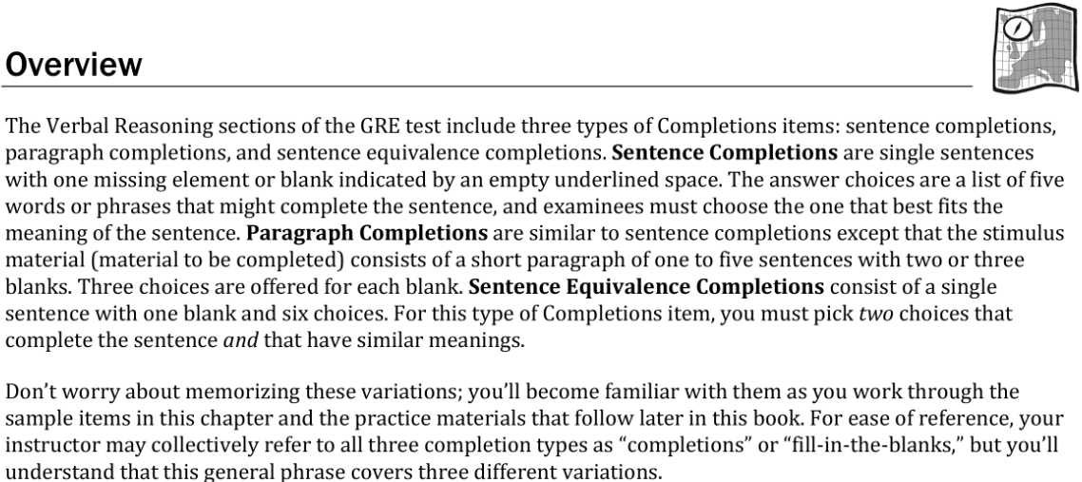
Verbal Reasoning: Completions Test Mechanics
21 • Verbal Reasoning: Completions
Notes:
Teacher’s Guide p. 51

Slide 4
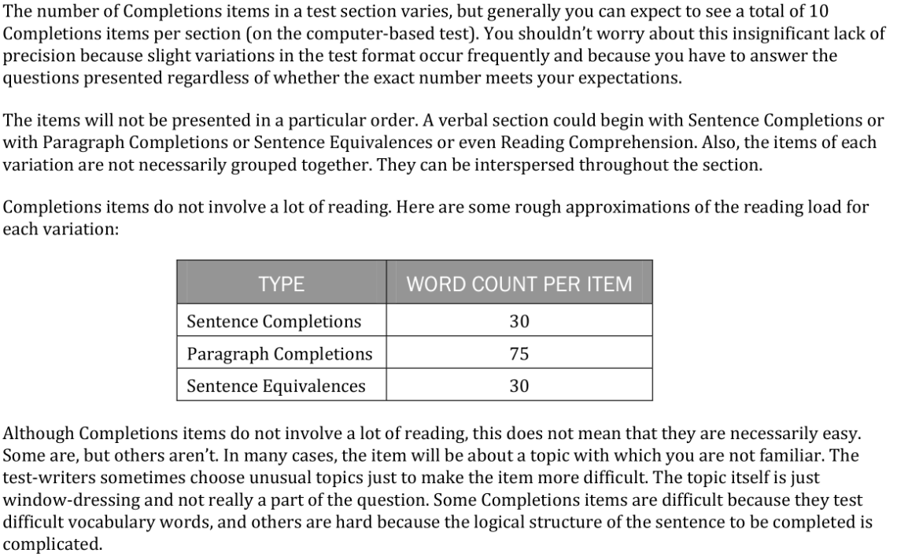
Verbal Reasoning: Completions Test Mechanics
21 • Verbal Reasoning: Completions
Notes:
Teacher’s Guide p. 51

Slide 5
Verbal Reasoning: Completions Anatomy Directions
22 • Verbal Reasoning: Completions
Notes:
Teacher’s Guide p. 53

Slide 6
Verbal Reasoning: Completions Anatomy Q1
22 • Verbal Reasoning: Completions
Notes:
Teacher’s Guide p. 53

Slide 7
Verbal Reasoning: Completions Anatomy Q2
22 • Verbal Reasoning: Completions
Notes:
Teacher’s Guide p. 53

Slide 8
Verbal Reasoning: Completions Anatomy Directions
22 • Verbal Reasoning: Completions
Notes:
Teacher’s Guide p. 53

Slide 9
Verbal Reasoning: Completions Anatomy Q3
22 • Verbal Reasoning: Completions
Notes:
Teacher’s Guide p. 53

Slide 10
Verbal Reasoning: Completions Anatomy Q4
23 • Verbal Reasoning: Completions
Notes:
Teacher’s Guide p. 54

Slide 11
Verbal Reasoning: Completions Anatomy Q5
23 • Verbal Reasoning: Completions
Notes:
Teacher’s Guide p. 54

Slide 12
Verbal Reasoning: Completions Anatomy Directions
23 • Verbal Reasoning: Completions
Notes:
Teacher’s Guide p. 54

Slide 13
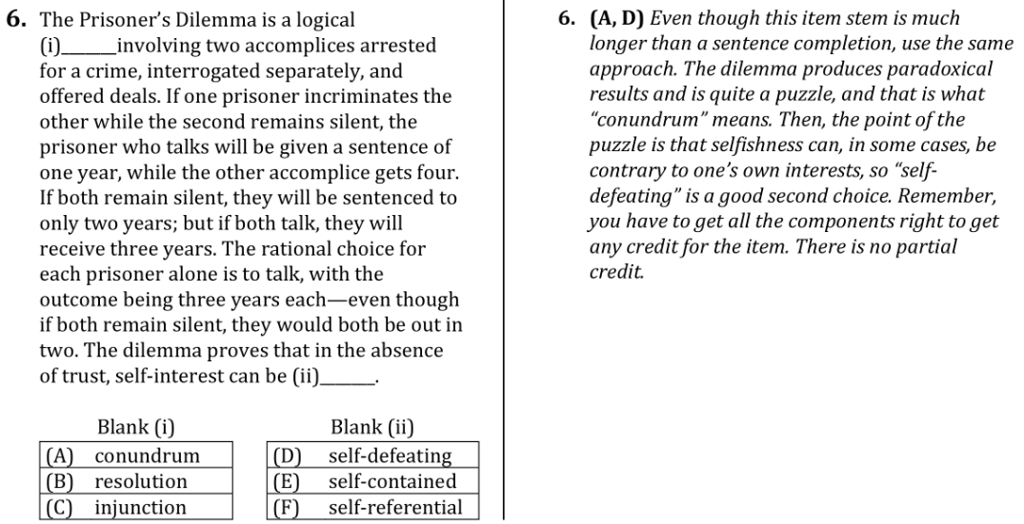
Verbal Reasoning: Completions Anatomy Q6
23 • Verbal Reasoning: Completions
Notes:
Teacher’s Guide p. 54

Slide 14
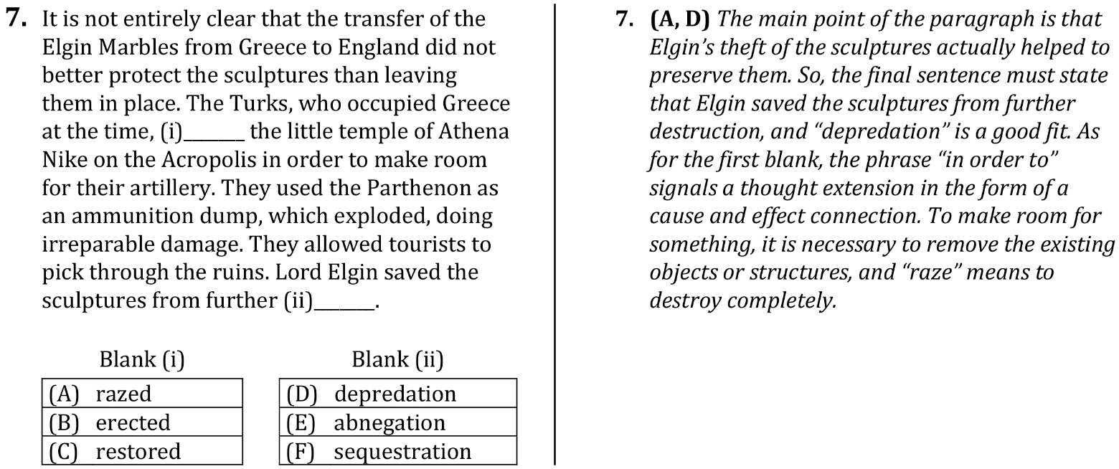
Verbal Reasoning: Completions Anatomy Q7
24 • Verbal Reasoning: Completions
Notes:
Teacher’s Guide p. 55

Slide 15
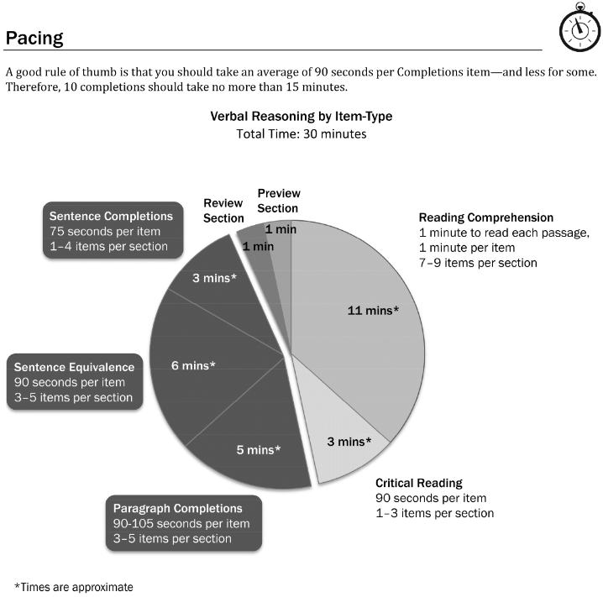
Verbal Reasoning: Completions Pacing
25 • Verbal Reasoning: Completions
Notes:
Teacher’s Guide p. 56

Slide 16
Verbal Reasoning: Completions Pacing
25 • Verbal Reasoning: Completions
Notes:
Teacher’s Guide p. 56

Slide 17
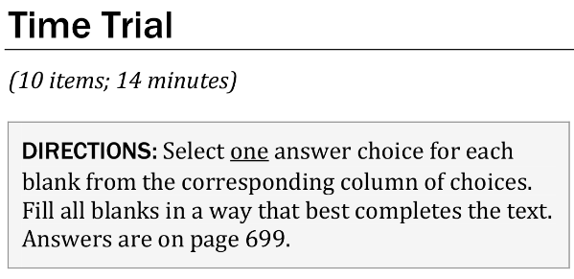
Verbal Reasoning: Completions Time Trial Directions
26 • Verbal Reasoning: Completions
Notes:
Teacher’s Guide p. 58

Slide 18
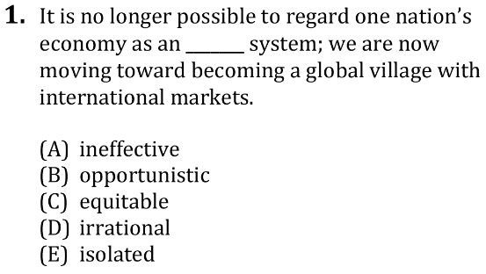
Verbal Reasoning: Completions Time Trial Q1
26 • Verbal Reasoning: Completions
Notes:
Teacher’s Guide p. 58

Slide 19
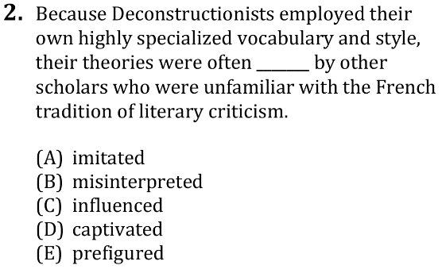
Verbal Reasoning: Completions Time Trial Q2
26 • Verbal Reasoning: Completions
Notes:
Teacher’s Guide p. 58

Slide 20
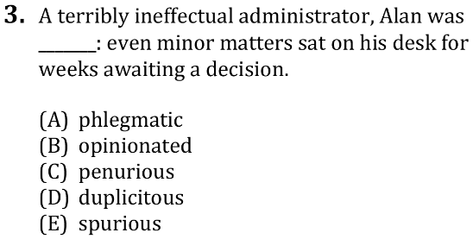
Verbal Reasoning: Completions Time Trial Q3
26 • Verbal Reasoning: Completions
Notes:
Teacher’s Guide p. 58

Slide 21
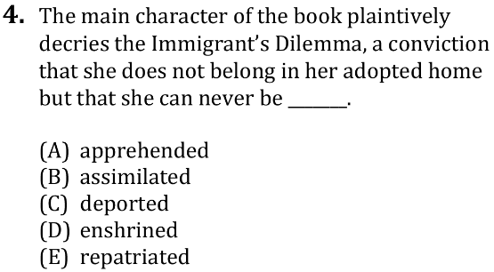
Verbal Reasoning: Completions Time Trial Q4
26 • Verbal Reasoning: Completions
Notes:
Teacher’s Guide p. 59

Slide 22
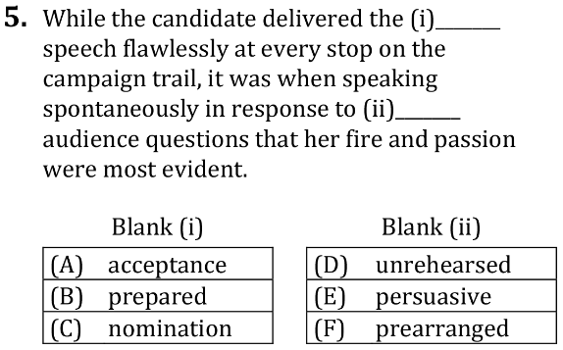
Verbal Reasoning: Completions Time Trial Q5
26 • Verbal Reasoning: Completions
Notes:
Teacher’s Guide p. 59

Slide 23
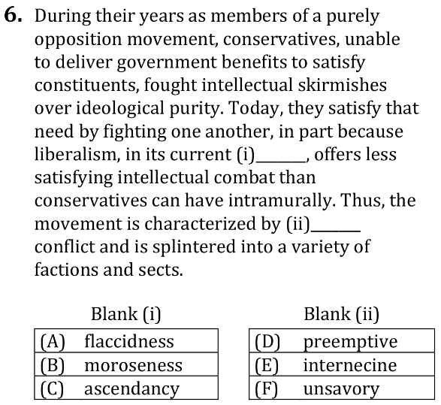
Verbal Reasoning: Completions Time Trial Q6
26 • Verbal Reasoning: Completions
Notes:
Teacher’s Guide p. 59

Slide 24
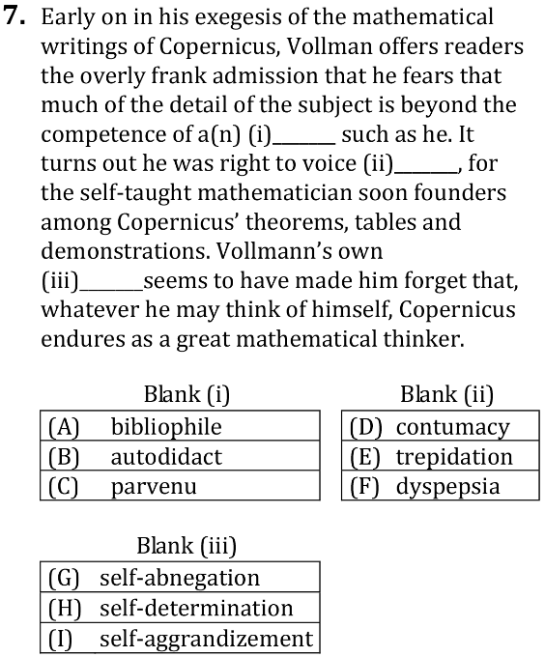
Verbal Reasoning: Completions Time Trial Q7
27 • Verbal Reasoning: Completions
Notes:
Teacher’s Guide p. 59

Slide 25
Verbal Reasoning: Completions Time Trial Directions
27 • Verbal Reasoning: Completions
Notes:
Teacher’s Guide p. 59

Slide 26
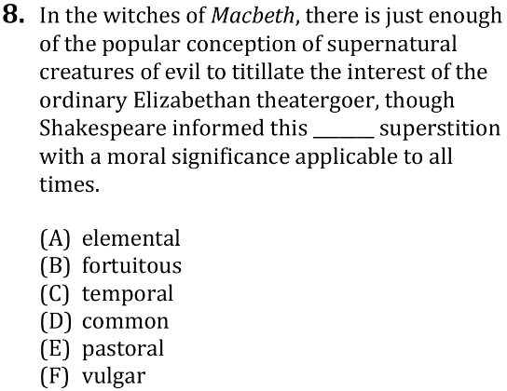
Verbal Reasoning: Completions Time Trial Q8
27 • Verbal Reasoning: Completions
Notes:
Teacher’s Guide p. 60

Slide 27
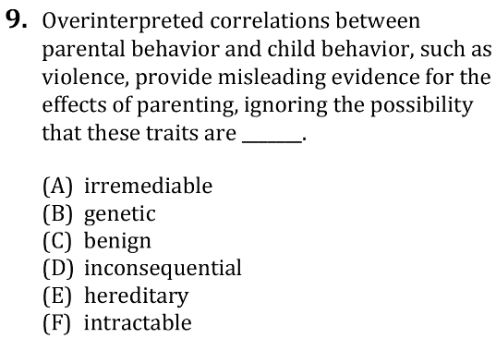
Verbal Reasoning: Completions Time Trial Q9
27 • Verbal Reasoning: Completions
Notes:
Teacher’s Guide p. 60

Slide 28
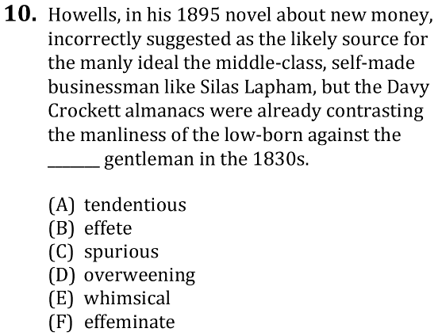
Verbal Reasoning: Completions Time Trial Q10
27 • Verbal Reasoning: Completions
Notes:
Teacher’s Guide p. 60

Slide 29
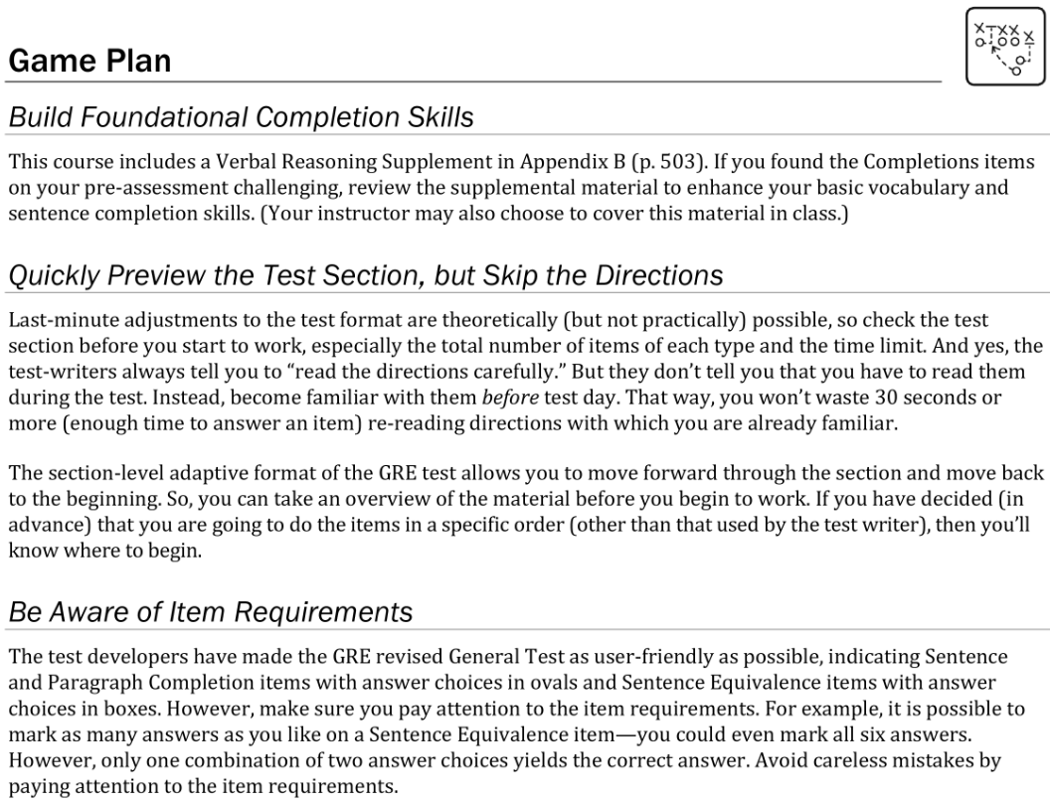
Verbal Reasoning: Completions Game Plan
28 • Verbal Reasoning: Completions
Notes:
Teacher’s Guide p. 61-62

Slide 30
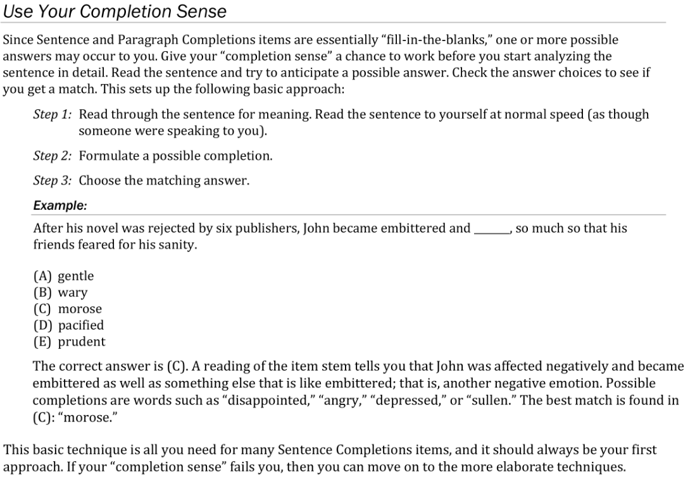
Verbal Reasoning: Completions Game Plan
28-29 • Verbal Reasoning: Completions
Notes:
Teacher’s Guide p. 61-62

Slide 31
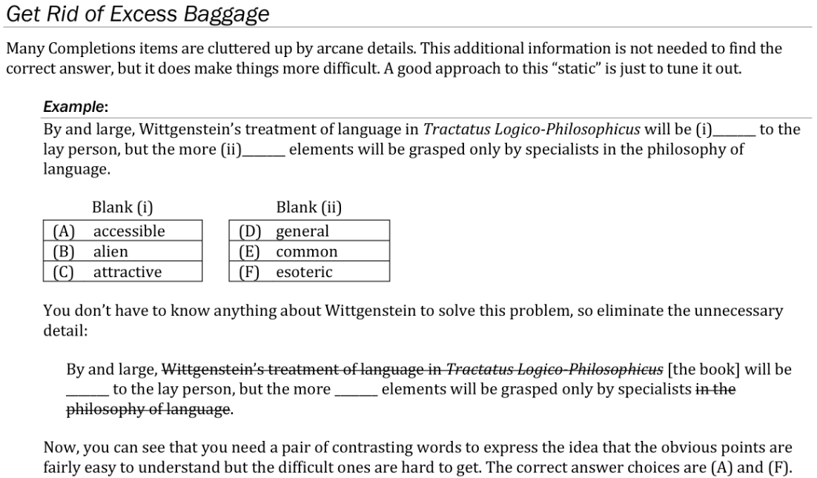
Verbal Reasoning: Completions Game Plan
29 • Verbal Reasoning: Completions
Notes:
Teacher’s Guide p. 63

Slide 32
Verbal Reasoning: Completions Game Plan
29 • Verbal Reasoning: Completions
Notes:
Teacher’s Guide p. 64

Slide 33
Verbal Reasoning: Completions Game Plan
30 • Verbal Reasoning: Completions
Notes:
Teacher’s Guide p. 64-65

Slide 34
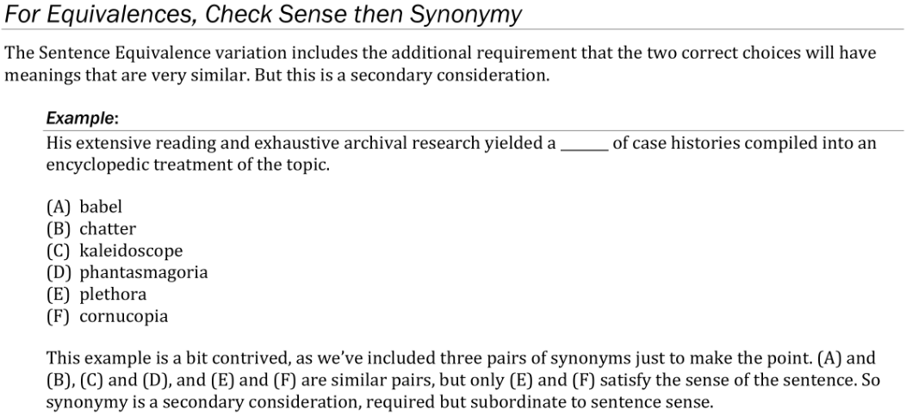
Verbal Reasoning: Completions Game Plan
30 • Verbal Reasoning: Completions
Notes:
Teacher’s Guide p. 65

Slide 35
Verbal Reasoning: Completions Game Plan
31 • Verbal Reasoning: Completions
Notes:
Teacher’s Guide p. 65-66

Slide 36
Verbal Reasoning: Completions Lesson Directions
33 • Verbal Reasoning: Completions
Notes:
Teacher’s Guide p. 68

Slide 37
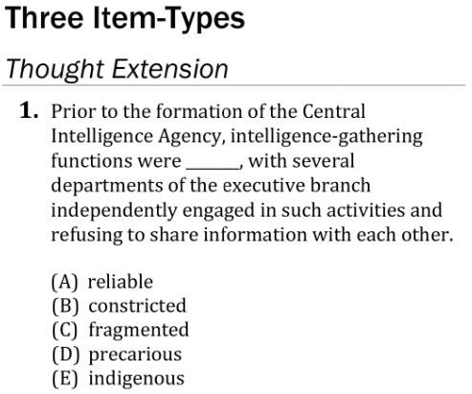
Verbal Reasoning: Completions Lesson Q1
33 • Verbal Reasoning: Completions
Notes:
Teacher’s Guide p. 68

Slide 38
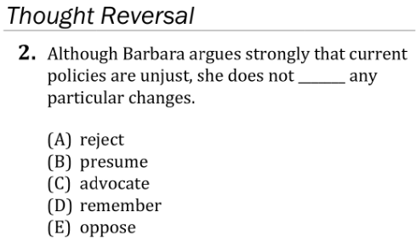
Verbal Reasoning: Completions Lesson Q2
33 • Verbal Reasoning: Completions
Notes:
Teacher’s Guide p. 69

Slide 39
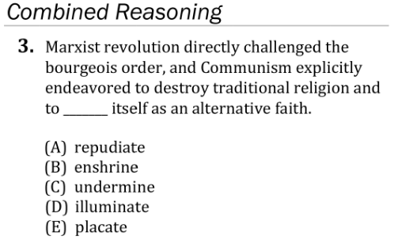
Verbal Reasoning: Completions Lesson Q3
33 • Verbal Reasoning: Completions
Notes:
Teacher’s Guide p. 69

Slide 40
Verbal Reasoning: Completions Lesson Q4
33 • Verbal Reasoning: Completions
Notes:
Teacher’s Guide p. 70

Slide 41
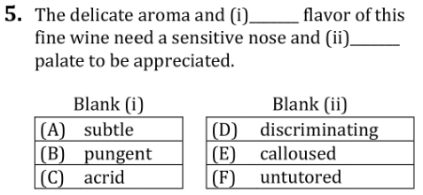
Verbal Reasoning: Completions Lesson Q5
33 • Verbal Reasoning: Completions
Notes:
Teacher’s Guide p. 70

Slide 42
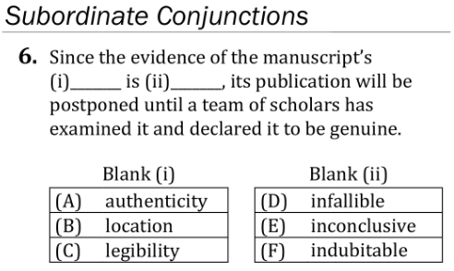
Verbal Reasoning: Completions Lesson Q6
34 • Verbal Reasoning: Completions
Notes:
Teacher’s Guide p. 71

Slide 43
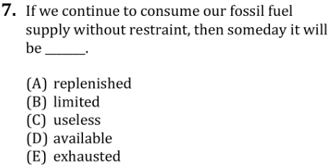
Verbal Reasoning: Completions Lesson Q7
34 • Verbal Reasoning: Completions
Notes:
Teacher’s Guide p. 71

Slide 44
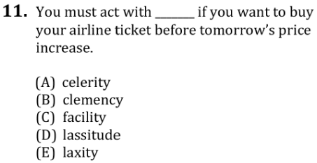
Verbal Reasoning: Completions Lesson Q11
34 • Verbal Reasoning: Completions
Notes:
Teacher’s Guide p. 72

Slide 45
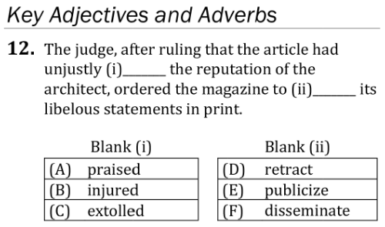
Verbal Reasoning: Completions Lesson Q12
34 • Verbal Reasoning: Completions
Notes:
Teacher’s Guide p. 72

Slide 46
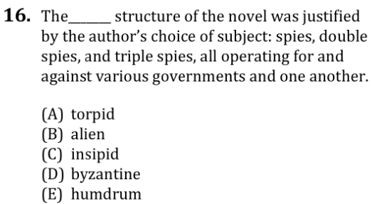
Verbal Reasoning: Completions Lesson Q16
35 • Verbal Reasoning: Completions
Notes:
Teacher’s Guide p. 73

Slide 47
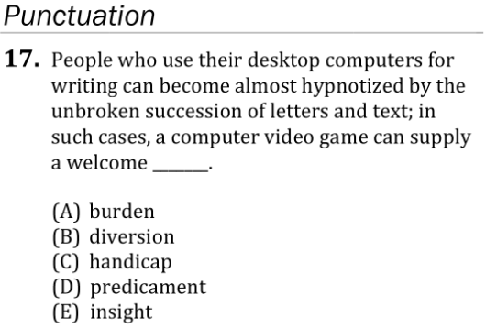
Verbal Reasoning: Completions Lesson Q17
35 • Verbal Reasoning: Completions
Notes:
Teacher’s Guide p. 74

Slide 48
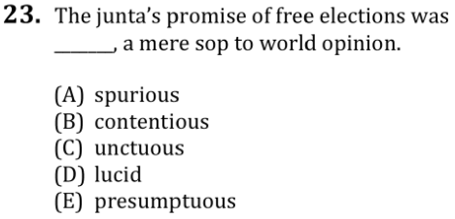
Verbal Reasoning: Completions Lesson Q23
35 • Verbal Reasoning: Completions
Notes:
Teacher’s Guide p. 75

Slide 49
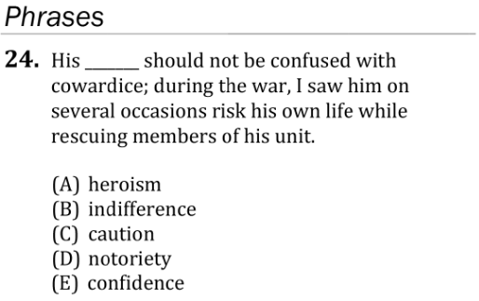
Verbal Reasoning: Completions Lesson Q24
36 • Verbal Reasoning: Completions
Notes:
Teacher’s Guide p. 76

Slide 50
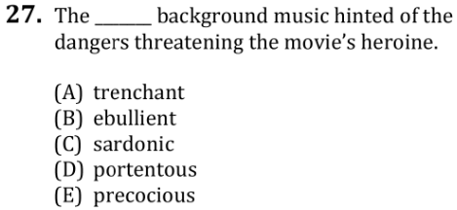
Verbal Reasoning: Completions Lesson Q27
36 • Verbal Reasoning: Completions
Notes:
Teacher’s Guide p. 76

Slide 51
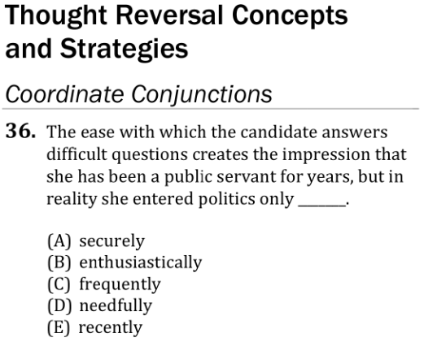
Verbal Reasoning: Completions Lesson Q36
37 • Verbal Reasoning: Completions
Notes:
Teacher’s Guide p. 79

Slide 52
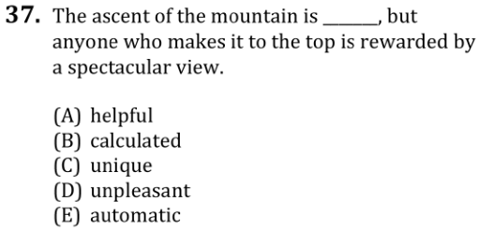
Verbal Reasoning: Completions Lesson Q37
37 • Verbal Reasoning: Completions
Notes:
Teacher’s Guide p. 79

Slide 53
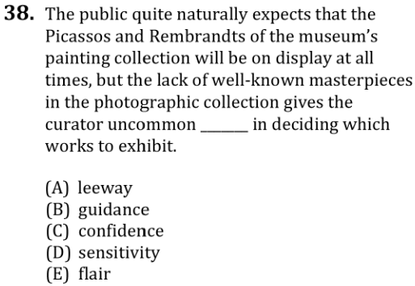
Verbal Reasoning: Completions Lesson Q38
37 • Verbal Reasoning: Completions
Notes:
Teacher’s Guide p. 79

Slide 54
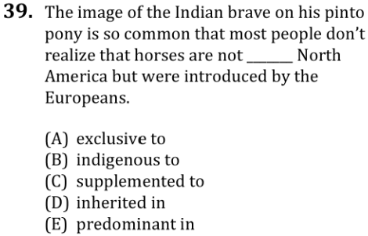
Verbal Reasoning: Completions Lesson Q39
37 • Verbal Reasoning: Completions
Notes:
Teacher’s Guide p. 80

Slide 55
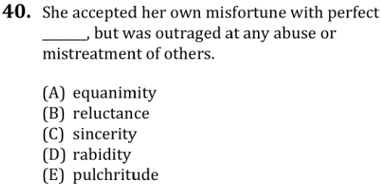
Verbal Reasoning: Completions Lesson Q40
37 • Verbal Reasoning: Completions
Notes:
Teacher’s Guide p. 80

Slide 56
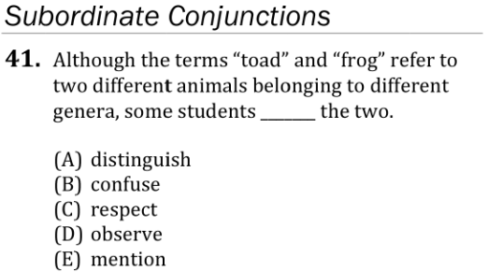
Verbal Reasoning: Completions Lesson Q41
37 • Verbal Reasoning: Completions
Notes:
Teacher’s Guide p. 80

Slide 57
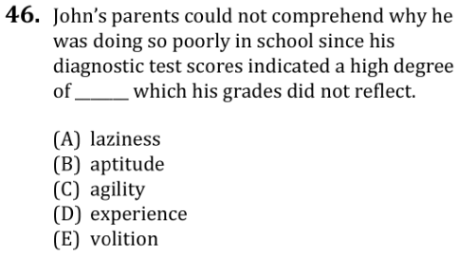
Verbal Reasoning: Completions Lesson Q46
38 • Verbal Reasoning: Completions
Notes:
Teacher’s Guide p. 82

Slide 58
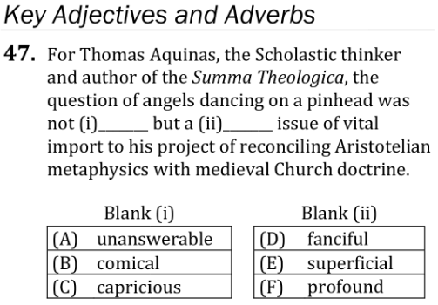
Verbal Reasoning: Completions Lesson Q47
38 • Verbal Reasoning: Completions
Notes:
Teacher’s Guide p. 82

Slide 59
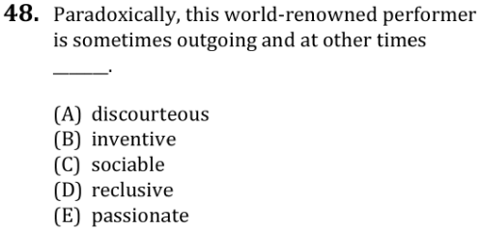
Verbal Reasoning: Completions Lesson Q48
38 • Verbal Reasoning: Completions
Notes:
Teacher’s Guide p. 82

Slide 60
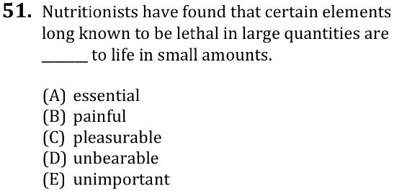
Verbal Reasoning: Completions Lesson Q51
39 • Verbal Reasoning: Completions
Notes:
Teacher’s Guide p. 83

Slide 61
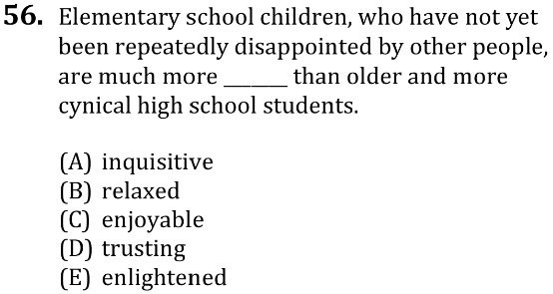
Verbal Reasoning: Completions Lesson Q56
39 • Verbal Reasoning: Completions
Notes:
Teacher’s Guide p. 85

Slide 62
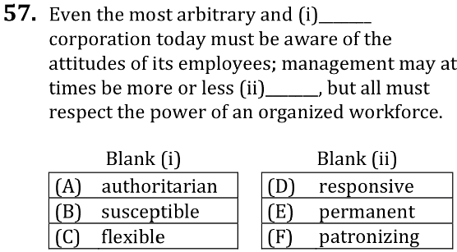
Verbal Reasoning: Completions Lesson Q57
39 • Verbal Reasoning: Completions
Notes:
Teacher’s Guide p. 85

Slide 63
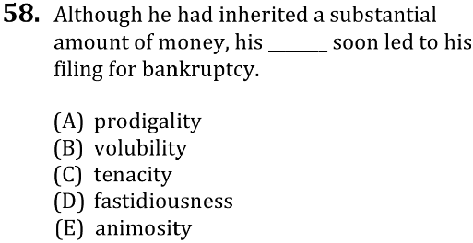
Verbal Reasoning: Completions Lesson Q58
39 • Verbal Reasoning: Completions
Notes:
Teacher’s Guide p. 85

Slide 64
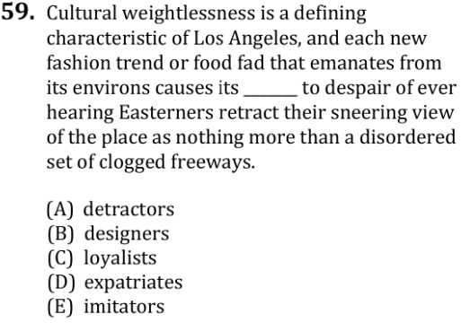
Verbal Reasoning: Completions Lesson Q59
40 • Verbal Reasoning: Completions
Notes:
Teacher’s Guide p. 86

Slide 65
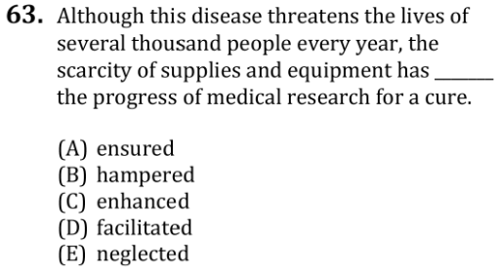
Verbal Reasoning: Completions Lesson Q63
40 • Verbal Reasoning: Completions
Notes:
Teacher’s Guide p. 87

Slide 66
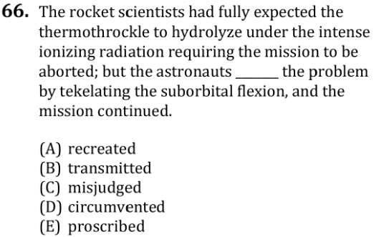
Verbal Reasoning: Completions Lesson Q66
40 • Verbal Reasoning: Completions
Notes:
Teacher’s Guide p. 89

Slide 67
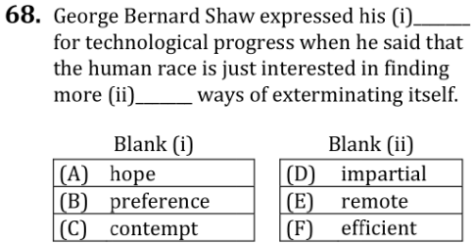
Verbal Reasoning: Completions Lesson Q68
41 • Verbal Reasoning: Completions
Notes:
Teacher’s Guide p. 90

Slide 68
Verbal Reasoning: Completions Lesson Q70
41 • Verbal Reasoning: Completions
Notes:
Teacher’s Guide p. 90

Slide 69
Verbal Reasoning: Completions Lesson Q78
43 • Verbal Reasoning: Completions
Notes:
Teacher’s Guide p. 94

Slide 70
Verbal Reasoning: Completions Lesson Q79
43 • Verbal Reasoning: Completions
Notes:
Teacher’s Guide p. 95

Slide 71
Verbal Reasoning: Completions Lesson Q80
43 • Verbal Reasoning: Completions
Notes:
Teacher’s Guide p. 95

Slide 72
Verbal Reasoning: Completions Lesson Q81
43 • Verbal Reasoning: Completions
Notes:
Teacher’s Guide p. 95

Slide 73
Verbal Reasoning: Completions Lesson Q82
43 • Verbal Reasoning: Completions
Notes:
Teacher’s Guide p. 96

Slide 74
Verbal Reasoning: Completions Lesson Q83
44 • Verbal Reasoning: Completions
Notes:
Teacher’s Guide p. 96

Slide 75
Verbal Reasoning: Completions Lesson Q89
45 • Verbal Reasoning: Completions
Notes:
Teacher’s Guide p. 98

Slide 76
Verbal Reasoning: Completions Lesson Q90
45 • Verbal Reasoning: Completions
Notes:
Teacher’s Guide p. 98

Slide 77
Verbal Reasoning: Completions Lesson Q91
45 • Verbal Reasoning: Completions
Notes:
Teacher’s Guide p. 99

Slide 78
Verbal Reasoning: Completions Lesson Q92
45 • Verbal Reasoning: Completions
Notes:
Teacher’s Guide p. 99

Slide 79
Verbal Reasoning: Completions Lesson Q93
45 • Verbal Reasoning: Completions
Notes:
Teacher’s Guide p. 99

Slide 80
Verbal Reasoning: Completions Lesson Q94
45 • Verbal Reasoning: Completions
Notes:
Teacher’s Guide p. 99

Slide 81
Verbal Reasoning: Completions Lesson Q95
45 • Verbal Reasoning: Completions
Notes:
Teacher’s Guide p. 100

Slide 82
Verbal Reasoning: Completions Lesson Q96
45 • Verbal Reasoning: Completions
Notes:
Teacher’s Guide p. 100

Slide 83
Verbal Reasoning: Reading Test Mechanics
61 • Verbal Reasoning: Reading
↖ Back to the Table of Contents
Notes:
Teacher’s Guide p. 125

Slide 84
Verbal Reasoning: Reading Test Mechanics
61 • Verbal Reasoning: Reading
Notes:
Teacher’s Guide p. 127

Slide 85
Verbal Reasoning: Reading Test Mechanics
61 • Verbal Reasoning: Reading
Notes:
Teacher’s Guide p. 127

Slide 86
Verbal Reasoning: Reading Anatomy Passage
62 • Verbal Reasoning: Reading
Notes:
Teacher’s Guide p. 128

Slide 87
Verbal Reasoning: Reading Anatomy Passage
62 • Verbal Reasoning: Reading
Notes:
Teacher’s Guide p. 128

Slide 88
Verbal Reasoning: Reading Anatomy Q1
63 • Verbal Reasoning: Reading
Notes:
Teacher’s Guide p. 129

Slide 89
Verbal Reasoning: Reading Anatomy Q2
63 • Verbal Reasoning: Reading
Notes:
Teacher’s Guide p. 129

Slide 90
Verbal Reasoning: Reading Anatomy Passage
64 • Verbal Reasoning: Reading
Notes:
Teacher’s Guide p. 130

Slide 91
Verbal Reasoning: Reading Anatomy Q3
64 • Verbal Reasoning: Reading
Notes:
Teacher’s Guide p. 130

Slide 92
Verbal Reasoning: Reading Pacing
65 • Verbal Reasoning: Reading
Notes:
Teacher’s Guide p. 131-132

Slide 93
Verbal Reasoning: Reading Pacing
65 • Verbal Reasoning: Reading
Notes:
Teacher’s Guide p. 131-132

Slide 94
Verbal Reasoning: Reading Time Trial Directions
66 • Verbal Reasoning: Reading
Notes:
Teacher’s Guide p. 133

Slide 95
Verbal Reasoning: Reading Time Trial Passage
66 • Verbal Reasoning: Reading
Notes:
Teacher’s Guide p. 133

Slide 96
Verbal Reasoning: Reading Time Trial Passage
66 • Verbal Reasoning: Reading
Notes:
Teacher’s Guide p. 133

Slide 97
Verbal Reasoning: Reading Time Trial Passage
66 • Verbal Reasoning: Reading
Notes:
Teacher’s Guide p. 133

Slide 98
Verbal Reasoning: Reading Time Trial Q1
66 • Verbal Reasoning: Reading
Notes:
Teacher’s Guide p. 134

Slide 99
Verbal Reasoning: Reading Time Trial Q2
67 • Verbal Reasoning: Reading
Notes:
Teacher’s Guide p. 134

Slide 100
Verbal Reasoning: Reading Time Trial Q3
67 • Verbal Reasoning: Reading
Notes:
Teacher’s Guide p. 134

Slide 101
Verbal Reasoning: Reading Time Trial Passage
67 • Verbal Reasoning: Reading
Notes:
Teacher’s Guide p. 135

Slide 102
Verbal Reasoning: Reading Time Trial Q4
67 • Verbal Reasoning: Reading
Notes:
Teacher’s Guide p. 135

Slide 103
Verbal Reasoning: Reading Game Plan
68 • Verbal Reasoning: Reading
Notes:
Teacher’s Guide p. 136

Slide 104
Verbal Reasoning: Reading Game Plan
68 • Verbal Reasoning: Reading
Notes:
Teacher’s Guide p. 136

Slide 105
Verbal Reasoning: Reading Game Plan
68 • Verbal Reasoning: Reading
Notes:
Teacher’s Guide p. 137

Slide 106
Verbal Reasoning: Reading Game Plan
69 • Verbal Reasoning: Reading
Notes:
Teacher’s Guide p. 137

Slide 107
Verbal Reasoning: Reading Game Plan
69 • Verbal Reasoning: Reading
Notes:
Teacher’s Guide p. 137

Slide 108
Verbal Reasoning: Reading Game Plan
69 • Verbal Reasoning: Reading
Notes:
Teacher’s Guide p. 138

Slide 109
Verbal Reasoning: Reading Game Plan
70 • Verbal Reasoning: Reading
Notes:
Teacher’s Guide p. 138

Slide 110
Verbal Reasoning: Reading Game Plan
70 • Verbal Reasoning: Reading
Notes:
Teacher’s Guide p. 138

Slide 111
Verbal Reasoning: Reading Game Plan
70-71 • Verbal Reasoning: Reading
Notes:
Teacher’s Guide p. 139

Slide 112
Verbal Reasoning: Reading Game Plan
71 • Verbal Reasoning: Reading
Notes:
Teacher’s Guide p. 139

Slide 113
Verbal Reasoning: Reading Game Plan
71 • Verbal Reasoning: Reading
Notes:
Teacher’s Guide p. 140

Slide 114
Verbal Reasoning: Reading Lesson Directions
73 • Verbal Reasoning: Reading
Notes:
Teacher’s Guide p. 143

Slide 115
Verbal Reasoning: Reading Lesson Passage
76 • Verbal Reasoning: Reading
Notes:
Teacher’s Guide p. 153

Slide 116
Verbal Reasoning: Reading Lesson Passage
76 • Verbal Reasoning: Reading
Notes:
Teacher’s Guide p. 153

Slide 117
Verbal Reasoning: Reading Lesson Q15
76 • Verbal Reasoning: Reading
Notes:
Teacher’s Guide p. 154

Slide 118
Verbal Reasoning: Reading Lesson Q16
76 • Verbal Reasoning: Reading
Notes:
Teacher’s Guide p. 154

Slide 119
Verbal Reasoning: Reading Lesson Q17
77 • Verbal Reasoning: Reading
Notes:
Teacher’s Guide p. 154

Slide 120
Verbal Reasoning: Reading Lesson Q18
77 • Verbal Reasoning: Reading
Notes:
Teacher’s Guide p. 155

Slide 121
Verbal Reasoning: Reading Lesson Q19
77 • Verbal Reasoning: Reading
Notes:
Teacher’s Guide p. 155

Slide 122
Verbal Reasoning: Reading Lesson Q20
77 • Verbal Reasoning: Reading
Notes:
Teacher’s Guide p. 156

Slide 123
Verbal Reasoning: Reading Lesson Q21
77 • Verbal Reasoning: Reading
Notes:
Teacher’s Guide p. 156

Slide 124
Verbal Reasoning: Reading Lesson Q22
77 • Verbal Reasoning: Reading
Notes:
Teacher’s Guide p. 156

Slide 125
Verbal Reasoning: Reading Lesson Q23
78 • Verbal Reasoning: Reading
Notes:
Teacher’s Guide p. 157

Slide 126
Verbal Reasoning: Reading Lesson Q24
78 • Verbal Reasoning: Reading
Notes:
Teacher’s Guide p. 157

Slide 127
Verbal Reasoning: Reading Lesson Q25
78 • Verbal Reasoning: Reading
Notes:
Teacher’s Guide p. 158

Slide 128
Verbal Reasoning: Reading Lesson Q26
78 • Verbal Reasoning: Reading
Notes:
Teacher’s Guide p. 158

Slide 129
Verbal Reasoning: Reading Lesson Passage
82 • Verbal Reasoning: Reading
Notes:
Teacher’s Guide p. 167

Slide 130
Verbal Reasoning: Reading Lesson Passage
82-83 • Verbal Reasoning: Reading
Notes:
Teacher’s Guide p. 167

Slide 131
Verbal Reasoning: Reading Lesson Passage
83 • Verbal Reasoning: Reading
Notes:
Teacher’s Guide p. 168

Slide 132
Verbal Reasoning: Reading Lesson Q44
83 • Verbal Reasoning: Reading
Notes:
Teacher’s Guide p. 168

Slide 133
Verbal Reasoning: Reading Lesson Q45
83 • Verbal Reasoning: Reading
Notes:
Teacher’s Guide p. 168

Slide 134
Verbal Reasoning: Reading Lesson Q46
83 • Verbal Reasoning: Reading
Notes:
Teacher’s Guide p. 169

Slide 135
Verbal Reasoning: Reading Lesson Q47
83 • Verbal Reasoning: Reading
Notes:
Teacher’s Guide p. 169

Slide 136
Verbal Reasoning: Reading Lesson Q48
83 • Verbal Reasoning: Reading
Notes:
Teacher’s Guide p. 169

Slide 137
Verbal Reasoning: Reading Lesson Q49
84 • Verbal Reasoning: Reading
Notes:
Teacher’s Guide p. 170

Slide 138
Verbal Reasoning: Reading Lesson Q50
84 • Verbal Reasoning: Reading
Notes:
Teacher’s Guide p. 170

Slide 139
Verbal Reasoning: Reading Lesson Passage
84 • Verbal Reasoning: Reading
Notes:
Teacher’s Guide p. 170-171

Slide 140
Verbal Reasoning: Reading Lesson Passage
84-85 • Verbal Reasoning: Reading
Notes:
Teacher’s Guide p. 171

Slide 141
Verbal Reasoning: Reading Lesson Q51
85 • Verbal Reasoning: Reading
Notes:
Teacher’s Guide p. 171

Slide 142
Verbal Reasoning: Reading Lesson Q52
85 • Verbal Reasoning: Reading
Notes:
Teacher’s Guide p. 171

Slide 143
Verbal Reasoning: Reading Lesson Q53
85 • Verbal Reasoning: Reading
Notes:
Teacher’s Guide p. 172

Slide 144
Verbal Reasoning: Reading Lesson Q54
85 • Verbal Reasoning: Reading
Notes:
Teacher’s Guide p. 172

Slide 145
Verbal Reasoning: Reading Lesson Q55
85 • Verbal Reasoning: Reading
Notes:
Teacher’s Guide p. 172

Slide 146
Verbal Reasoning: Reading Lesson Q56
85 • Verbal Reasoning: Reading
Notes:
Teacher’s Guide p. 173

Slide 147
Verbal Reasoning: Reading Lesson Q57
85 • Verbal Reasoning: Reading
Notes:
Teacher’s Guide p. 173

Slide 148
Verbal Reasoning: Reading Lesson Passage
86 • Verbal Reasoning: Reading
Notes:
Teacher’s Guide p. 173-174

Slide 149
Verbal Reasoning: Reading Lesson Passage
86 • Verbal Reasoning: Reading
Notes:
Teacher’s Guide p. 174

Slide 150
Verbal Reasoning: Reading Lesson Q58
86 • Verbal Reasoning: Reading
86 • Verbal Reasoning: Reading
Notes:
Teacher’s Guide p. 174

Slide 151
Verbal Reasoning: Reading Lesson Q59
86 • Verbal Reasoning: Reading
Notes:
Teacher’s Guide p. 174

Slide 152
Verbal Reasoning: Reading Lesson Q60
87 • Verbal Reasoning: Reading
Notes:
Teacher’s Guide p. 175

Slide 153
Verbal Reasoning: Reading Lesson Q61
87 • Verbal Reasoning: Reading
Notes:
Teacher’s Guide p. 175

Slide 154
Verbal Reasoning: Reading Lesson Q62
87 • Verbal Reasoning: Reading
Notes:
Teacher’s Guide p. 175

Slide 155
Verbal Reasoning: Reading Lesson Q63
87 • Verbal Reasoning: Reading
Notes:
Teacher’s Guide p. 176

Slide 156
Verbal Reasoning: Reading Lesson Q64
87 • Verbal Reasoning: Reading
Notes:
Teacher’s Guide p. 176

Slide 157
Verbal Reasoning: Reading Lesson Passage
88 • Verbal Reasoning: Reading
Notes:
Teacher’s Guide p. 176-177

Slide 158
Verbal Reasoning: Reading Lesson Passage
88 • Verbal Reasoning: Reading
Notes:
Teacher’s Guide p. 177

Slide 159
Verbal Reasoning: Reading Lesson Q65
88 • Verbal Reasoning: Reading
Notes:
Teacher’s Guide p. 177

Slide 160
Verbal Reasoning: Reading Lesson Q66
88 • Verbal Reasoning: Reading
Notes:
Teacher’s Guide p. 178

Slide 161
Verbal Reasoning: Reading Lesson Q67
88 • Verbal Reasoning: Reading
Notes:
Teacher’s Guide p. 178

Slide 162
Verbal Reasoning: Reading Lesson Q68
89 • Verbal Reasoning: Reading
Notes:
Teacher’s Guide p. 178

Slide 163
Verbal Reasoning: Reading Lesson Q69
89 • Verbal Reasoning: Reading
Notes:
Teacher’s Guide p. 179

Slide 164
Verbal Reasoning: Reading Lesson Q70
89 • Verbal Reasoning: Reading
Notes:
Teacher’s Guide p. 179

Slide 165
Verbal Reasoning: Reading Lesson Q71
89 • Verbal Reasoning: Reading
Notes:
Teacher’s Guide p. 179

Slide 166
Verbal Reasoning: Reading Lesson Q72
89 • Verbal Reasoning: Reading
Notes:
Teacher’s Guide p. 180

Slide 167
Verbal Reasoning: Reading Lesson Q73
89 • Verbal Reasoning: Reading
Notes:
Teacher’s Guide p. 180

Slide 168
Verbal Reasoning: Reading Lesson Passage
110 • Verbal Reasoning: Reading
Notes:
Teacher’s Guide p. 215

Slide 169
Verbal Reasoning: Reading Lesson Passage
110-111 • Verbal Reasoning: Reading
Notes:
Teacher’s Guide p. 215

Slide 170
Verbal Reasoning: Reading Lesson Q141
111 • Verbal Reasoning: Reading
Notes:
Teacher’s Guide p. 216

Slide 171
Verbal Reasoning: Reading Lesson Q142
111 • Verbal Reasoning: Reading
Notes:
Teacher’s Guide p. 216

Slide 172
Verbal Reasoning: Reading Lesson Q143
111 • Verbal Reasoning: Reading
Notes:
Teacher’s Guide p. 216

Slide 173
Verbal Reasoning: Reading Lesson Q144
111 • Verbal Reasoning: Reading
Notes:
Teacher’s Guide p. 216

Slide 174
Verbal Reasoning: Reading Lesson Q145
112 • Verbal Reasoning: Reading
Notes:
Teacher’s Guide p. 217

Slide 175
Verbal Reasoning: Reading Lesson Q146
112 • Verbal Reasoning: Reading
Notes:
Teacher’s Guide p. 217

Slide 176
Verbal Reasoning: Reading Lesson Passage
112 • Verbal Reasoning: Reading
Notes:
Teacher’s Guide p. 217

Slide 177
Verbal Reasoning: Reading Lesson Passage
112-113 • Verbal Reasoning: Reading
Notes:
Teacher’s Guide p. 217-218

Slide 178
Verbal Reasoning: Reading Lesson Q147
113 • Verbal Reasoning: Reading
Notes:
Teacher’s Guide p. 218

Slide 179
Verbal Reasoning: Reading Lesson Q148
113 • Verbal Reasoning: Reading
Notes:
Teacher’s Guide p. 218

Slide 180
Verbal Reasoning: Reading Lesson Q149
113 • Verbal Reasoning: Reading
Notes:
Teacher’s Guide p. 219

Slide 181
Verbal Reasoning: Reading Lesson Q150
113 • Verbal Reasoning: Reading
Notes:
Teacher’s Guide p. 219

Slide 182
Verbal Reasoning: Reading Lesson Q151
114 • Verbal Reasoning: Reading
Notes:
Teacher’s Guide p. 220

Slide 183
Verbal Reasoning: Reading Lesson Q152
114 • Verbal Reasoning: Reading
Notes:
Teacher’s Guide p. 220

Slide 184
Verbal Reasoning: Reading Lesson Q153
114 • Verbal Reasoning: Reading
Notes:
Teacher’s Guide p. 221

Slide 185
Verbal Reasoning: Reading Lesson Q159
117 • Verbal Reasoning: Reading
Notes:
Teacher’s Guide p. 227

Slide 186
Verbal Reasoning: Reading Lesson Q160
117 • Verbal Reasoning: Reading
Notes:
Teacher’s Guide p. 227

Slide 187
Verbal Reasoning: Reading Lesson Q161
117 • Verbal Reasoning: Reading
Notes:
Teacher’s Guide p. 228

Slide 188
Verbal Reasoning: Reading Lesson Q162
118 • Verbal Reasoning: Reading
Notes:
Teacher’s Guide p. 228

Slide 189
Verbal Reasoning: Reading Lesson Q168
120 • Verbal Reasoning: Reading
Notes:
Teacher’s Guide p. 233

Slide 190
Verbal Reasoning: Reading Lesson Q169
121 • Verbal Reasoning: Reading
Notes:
Teacher’s Guide p. 233

Slide 191
Verbal Reasoning: Reading Lesson Q170
121 • Verbal Reasoning: Reading
Notes:
Teacher’s Guide p. 234

Slide 192
Verbal Reasoning: Reading Lesson Q171
122 • Verbal Reasoning: Reading
Notes:
Teacher’s Guide p. 235

Slide 193
Verbal Reasoning: Reading Lesson Q178
125 • Verbal Reasoning: Reading
Notes:
Teacher’s Guide p. 239

Slide 194
Verbal Reasoning: Reading Lesson Q179
126 • Verbal Reasoning: Reading
Notes:
Teacher’s Guide p. 240

Slide 195
Verbal Reasoning: Reading Lesson Q180
126 • Verbal Reasoning: Reading
Notes:
Teacher’s Guide p. 240

Slide 196
Verbal Reasoning: Reading Lesson Q181
126 • Verbal Reasoning: Reading
Notes:
Teacher’s Guide p. 241

Slide 197
Verbal Reasoning: Reading Lesson Q184
127 • Verbal Reasoning: Reading
Notes:
Teacher’s Guide p. 242

Slide 198
Verbal Reasoning: Reading Lesson Q185
128 • Verbal Reasoning: Reading
Notes:
Teacher’s Guide p. 243

Slide 199
Verbal Reasoning: Reading Lesson Q186
128 • Verbal Reasoning: Reading
Notes:
Teacher’s Guide p. 243

Slide 200
Verbal Reasoning: Reading Lesson Q187
129 • Verbal Reasoning: Reading
Notes:
Teacher’s Guide p. 244

Slide 201
Verbal Reasoning: Reading Lesson Q188
129 • Verbal Reasoning: Reading
Notes:
Teacher’s Guide p. 244

Slide 202
Verbal Reasoning: Reading Lesson Q189
129 • Verbal Reasoning: Reading
Notes:
Teacher’s Guide p. 245

Slide 203
Verbal Reasoning: Reading Lesson Q190
129 • Verbal Reasoning: Reading
Notes:
Teacher’s Guide p. 245

Slide 204
Verbal Reasoning: Reading Lesson Q193
130 • Verbal Reasoning: Reading
Notes:
Teacher’s Guide p. 247

Slide 205
Verbal Reasoning: Reading Lesson Q196
131 • Verbal Reasoning: Reading
Notes:
Teacher’s Guide p. 249

Slide 206
Verbal Reasoning: Reading Lesson Q200
133 • Verbal Reasoning: Reading
Notes:
Teacher’s Guide p. 251

Slide 207
Quantitative Reasoning: Discrete Quantitative Test Mechanics
155 • Quantitative Reasoning: Discrete Quantitative
↖ Back to the Table of Contents
Notes:
Teacher’s Guide p. 273

Slide 208
Quantitative Reasoning: Discrete Quantitative Test Mechanics
155 • Quantitative Reasoning: Discrete Quantitative
Notes:
Teacher’s Guide p. 277

Slide 209
Quantitative Reasoning: Discrete Quantitative Test Mechanics
155 • Quantitative Reasoning: Discrete Quantitative
Notes:
Teacher’s Guide p. 277

Slide 210
Quantitative Reasoning: Discrete Quantitative Anatomy Directions
156 • Quantitative Reasoning: Discrete Quantitative
Notes:
Teacher’s Guide p. 278

Slide 211
Quantitative Reasoning: Discrete Quantitative Anatomy Q1
156 • Quantitative Reasoning: Discrete Quantitative
Notes:
Teacher’s Guide p. 278

Slide 212
Quantitative Reasoning: Discrete Quantitative Anatomy Q2
156 • Quantitative Reasoning: Discrete Quantitative
Notes:
Teacher’s Guide p. 279

Slide 213
Quantitative Reasoning: Discrete Quantitative Anatomy Q3
157 • Quantitative Reasoning: Discrete Quantitative
Notes:
Teacher’s Guide p. 279

Slide 214
Quantitative Reasoning: Discrete Quantitative Anatomy Q4
157 • Quantitative Reasoning: Discrete Quantitative
Notes:
Teacher’s Guide p. 279

Slide 215
Quantitative Reasoning: Discrete Quantitative Anatomy Q5
157 • Quantitative Reasoning: Discrete Quantitative
Notes:
Teacher’s Guide p. 280

Slide 216
Quantitative Reasoning: Discrete Quantitative Anatomy Text
158 • Quantitative Reasoning: Discrete Quantitative
Notes:
Teacher’s Guide p. 280

Slide 217
Quantitative Reasoning: Discrete Quantitative Pacing
159 • Quantitative Reasoning: Discrete Quantitative
Notes:
Teacher’s Guide p. 281

Slide 218
Quantitative Reasoning: Discrete Quantitative Pacing
159 • Quantitative Reasoning: Discrete Quantitative
Notes:
Teacher’s Guide p. 282

Slide 219
Quantitative Reasoning: Discrete Quantitative Time Trial Directions
160 • Quantitative Reasoning: Discrete Quantitative
Notes:
Teacher’s Guide p. 283

Slide 220
Quantitative Reasoning: Discrete Quantitative Time Trial Q1
160 • Quantitative Reasoning: Discrete Quantitative
Notes:
Teacher’s Guide p. 283

Slide 221
Quantitative Reasoning: Discrete Quantitative Time Trial Q2
160 • Quantitative Reasoning: Discrete Quantitative
Notes:
Teacher’s Guide p. 283

Slide 222
Quantitative Reasoning: Discrete Quantitative Time Trial Q3
160 • Quantitative Reasoning: Discrete Quantitative
Notes:
Teacher’s Guide p. 284

Slide 223
Quantitative Reasoning: Discrete Quantitative Time Trial Q4
160 • Quantitative Reasoning: Discrete Quantitative
Notes:
Teacher’s Guide p. 284

Slide 224
Quantitative Reasoning: Discrete Quantitative Time Trial Q5
160 • Quantitative Reasoning: Discrete Quantitative
Notes:
Teacher’s Guide p. 284

Slide 225
Quantitative Reasoning: Discrete Quantitative Game Plan
161 • Quantitative Reasoning: Discrete Quantitative
Notes:
Teacher’s Guide p. 286

Slide 226
Quantitative Reasoning: Discrete Quantitative Game Plan
161 • Quantitative Reasoning: Discrete Quantitative
Notes:
Teacher’s Guide p. 286

Slide 227
Quantitative Reasoning: Discrete Quantitative Game Plan
161-162 • Quantitative Reasoning: Discrete Quantitative
Notes:
Teacher’s Guide p. 286-287

Slide 228
Quantitative Reasoning: Discrete Quantitative Game Plan
162 • Quantitative Reasoning: Discrete Quantitative
Notes:
Teacher’s Guide p. 287-288

Slide 229
Quantitative Reasoning: Discrete Quantitative Game Plan
162 • Quantitative Reasoning: Discrete Quantitative
Notes:
Teacher’s Guide p. 288

Slide 230
Quantitative Reasoning: Discrete Quantitative Game Plan
163 • Quantitative Reasoning: Discrete Quantitative
Notes:
Teacher’s Guide p. 288-289

Slide 231
Quantitative Reasoning: Discrete Quantitative Game Plan
163 • Quantitative Reasoning: Discrete Quantitative
Notes:
Teacher’s Guide p. 289

Slide 232
Quantitative Reasoning: Discrete Quantitative Game Plan
163-164 • Quantitative Reasoning: Discrete Quantitative
Notes:
Teacher’s Guide p. 289-290

Slide 233
Quantitative Reasoning: Discrete Quantitative Game Plan
164 • Quantitative Reasoning: Discrete Quantitative
Notes:
Teacher’s Guide p. 290

Slide 234
Quantitative Reasoning: Discrete Quantitative Lesson Directions
165 • Quantitative Reasoning: Discrete Quantitative
Notes:
Teacher’s Guide p. 296

Slide 235
Quantitative Reasoning: Discrete Quantitative Lesson Q1
165 • Quantitative Reasoning: Discrete Quantitative
Notes:
Teacher’s Guide p. 297

Slide 236
Quantitative Reasoning: Discrete Quantitative Lesson Q2
165 • Quantitative Reasoning: Discrete Quantitative
Notes:
Teacher’s Guide p. 297

Slide 237
Quantitative Reasoning: Discrete Quantitative Lesson Q3
165 • Quantitative Reasoning: Discrete Quantitative
Notes:
Teacher’s Guide p. 297

Slide 238
Quantitative Reasoning: Discrete Quantitative Lesson Q4
165 • Quantitative Reasoning: Discrete Quantitative
Notes:
Teacher’s Guide p. 297

Slide 239
Quantitative Reasoning: Discrete Quantitative Lesson Q5
166 • Quantitative Reasoning: Discrete Quantitative
Notes:
Teacher’s Guide p. 298

Slide 240
Quantitative Reasoning: Discrete Quantitative Lesson Q6
166 • Quantitative Reasoning: Discrete Quantitative
Notes:
Teacher’s Guide p. 298

Slide 241
Quantitative Reasoning: Discrete Quantitative Lesson Q7
166 • Quantitative Reasoning: Discrete Quantitative
Notes:
Teacher’s Guide p. 298

Slide 242
Quantitative Reasoning: Discrete Quantitative Lesson Q8
166 • Quantitative Reasoning: Discrete Quantitative
Notes:
Teacher’s Guide p. 299

Slide 243
Quantitative Reasoning: Discrete Quantitative Lesson Q9
166 • Quantitative Reasoning: Discrete Quantitative
Notes:
Teacher’s Guide p. 299

Slide 244
Quantitative Reasoning: Discrete Quantitative Lesson Q13
167 • Quantitative Reasoning: Discrete Quantitative
Notes:
Teacher’s Guide p. 301

Slide 245
Quantitative Reasoning: Discrete Quantitative Lesson Q16
167 • Quantitative Reasoning: Discrete Quantitative
Notes:
Teacher’s Guide p. 302

Slide 246
Quantitative Reasoning: Discrete Quantitative Lesson Q19
168 • Quantitative Reasoning: Discrete Quantitative
Notes:
Teacher’s Guide p. 304

Slide 247
Quantitative Reasoning: Discrete Quantitative Lesson Q24
169 • Quantitative Reasoning: Discrete Quantitative
Notes:
Teacher’s Guide p. 306

Slide 248
Quantitative Reasoning: Discrete Quantitative Lesson Q31
170 • Quantitative Reasoning: Discrete Quantitative
Notes:
Teacher’s Guide p. 308

Slide 249
Quantitative Reasoning: Discrete Quantitative Lesson Q32
170 • Quantitative Reasoning: Discrete Quantitative
Notes:
Teacher’s Guide p. 309

Slide 250
Quantitative Reasoning: Discrete Quantitative Lesson Q33
170 • Quantitative Reasoning: Discrete Quantitative
Notes:
Teacher’s Guide p. 309

Slide 251
Quantitative Reasoning: Discrete Quantitative Lesson Q34
170 • Quantitative Reasoning: Discrete Quantitative
Notes:
Teacher’s Guide p. 310

Slide 252
Quantitative Reasoning: Discrete Quantitative Lesson Q36
170 • Quantitative Reasoning: Discrete Quantitative
Notes:
Teacher’s Guide p. 312

Slide 253
Quantitative Reasoning: Discrete Quantitative Lesson Q37
171 • Quantitative Reasoning: Discrete Quantitative
Notes:
Teacher’s Guide p. 312

Slide 254
Quantitative Reasoning: Discrete Quantitative Lesson Q38
171 • Quantitative Reasoning: Discrete Quantitative
Notes:
Teacher’s Guide p. 312

Slide 255
Quantitative Reasoning: Discrete Quantitative Lesson Q40
171 • Quantitative Reasoning: Discrete Quantitative
Notes:
Teacher’s Guide p. 313

Slide 256
Quantitative Reasoning: Discrete Quantitative Lesson Q41
171 • Quantitative Reasoning: Discrete Quantitative
Notes:
Teacher’s Guide p. 314

Slide 257
Quantitative Reasoning: Discrete Quantitative Lesson Q42
171 • Quantitative Reasoning: Discrete Quantitative
Notes:
Teacher’s Guide p. 314

Slide 258
Quantitative Reasoning: Discrete Quantitative Lesson Q48
172 • Quantitative Reasoning: Discrete Quantitative
Notes:
Teacher’s Guide p. 317

Slide 259
Quantitative Reasoning: Discrete Quantitative Lesson Q50
173 • Quantitative Reasoning: Discrete Quantitative
Notes:
Teacher’s Guide p. 318

Slide 260
Quantitative Reasoning: Discrete Quantitative Lesson Q52
173 • Quantitative Reasoning: Discrete Quantitative
Notes:
Teacher’s Guide p. 319

Slide 261
Quantitative Reasoning: Discrete Quantitative Lesson Q55
173 • Quantitative Reasoning: Discrete Quantitative
Notes:
Teacher’s Guide p. 321

Slide 262
Quantitative Reasoning: Discrete Quantitative Lesson Q58
174 • Quantitative Reasoning: Discrete Quantitative
Notes:
Teacher’s Guide p. 322

Slide 263
Quantitative Reasoning: Discrete Quantitative Lesson Q60
174 • Quantitative Reasoning: Discrete Quantitative
Notes:
Teacher’s Guide p. 323

Slide 264
Quantitative Reasoning: Discrete Quantitative Lesson Q63
174 • Quantitative Reasoning: Discrete Quantitative
Notes:
Teacher’s Guide p. 324

Slide 265
Quantitative Reasoning: Discrete Quantitative Lesson Q69
175 • Quantitative Reasoning: Discrete Quantitative
Notes:
Teacher’s Guide p. 326

Slide 266
Quantitative Reasoning: Discrete Quantitative Lesson Q73
175 • Quantitative Reasoning: Discrete Quantitative
Notes:
Teacher’s Guide p. 328

Slide 267
Quantitative Reasoning: Discrete Quantitative Lesson Q74
176 • Quantitative Reasoning: Discrete Quantitative
Notes:
Teacher’s Guide p. 329

Slide 268
Quantitative Reasoning: Discrete Quantitative Lesson Q79
176 • Quantitative Reasoning: Discrete Quantitative
Notes:
Teacher’s Guide p. 331

Slide 269
Quantitative Reasoning: Discrete Quantitative Lesson Q80
176 • Quantitative Reasoning: Discrete Quantitative
Notes:
Teacher’s Guide p. 331

Slide 270
Quantitative Reasoning: Discrete Quantitative Lesson Q81
177 • Quantitative Reasoning: Discrete Quantitative
Notes:
Teacher’s Guide p. 332

Slide 271
Quantitative Reasoning: Discrete Quantitative Lesson Q83
177 • Quantitative Reasoning: Discrete Quantitative
Notes:
Teacher’s Guide p. 333

Slide 272
Quantitative Reasoning: Discrete Quantitative Lesson Q85
177 • Quantitative Reasoning: Discrete Quantitative
Notes:
Teacher’s Guide p. 333

Slide 273
Quantitative Reasoning: Discrete Quantitative Lesson Q86
177 • Quantitative Reasoning: Discrete Quantitative
Notes:
Teacher’s Guide p. 334

Slide 274
Quantitative Reasoning: Discrete Quantitative Lesson Q87
177 • Quantitative Reasoning: Discrete Quantitative
Notes:
Teacher’s Guide p. 334

Slide 275
Quantitative Reasoning: Discrete Quantitative Lesson Q88
177 • Quantitative Reasoning: Discrete Quantitative
Notes:
Teacher’s Guide p. 335

Slide 276
Quantitative Reasoning: Discrete Quantitative Lesson Q89
178 • Quantitative Reasoning: Discrete Quantitative
Notes:
Teacher’s Guide p. 336

Slide 277
Quantitative Reasoning: Discrete Quantitative Lesson Q92
178 • Quantitative Reasoning: Discrete Quantitative
Notes:
Teacher’s Guide p. 338

Slide 278
Quantitative Reasoning: Discrete Quantitative Lesson Q100
181 • Quantitative Reasoning: Discrete Quantitative
Notes:
Teacher’s Guide p. 345

Slide 279
Quantitative Reasoning: Discrete Quantitative Lesson Q103
181 • Quantitative Reasoning: Discrete Quantitative
Notes:
Teacher’s Guide p. 347

Slide 280
Quantitative Reasoning: Discrete Quantitative Lesson Q104
181 • Quantitative Reasoning: Discrete Quantitative
Notes:
Teacher’s Guide p. 347

Slide 281
Quantitative Reasoning: Discrete Quantitative Lesson Q105
181 • Quantitative Reasoning: Discrete Quantitative
Notes:
Teacher’s Guide p. 348

Slide 282
Quantitative Reasoning: Discrete Quantitative Lesson Q107
182 • Quantitative Reasoning: Discrete Quantitative
Notes:
Teacher’s Guide p. 348

Slide 283
Quantitative Reasoning: Discrete Quantitative Lesson Q108
182 • Quantitative Reasoning: Discrete Quantitative
Notes:
Teacher’s Guide p. 349

Slide 284
Quantitative Reasoning: Discrete Quantitative Lesson Q114
183 • Quantitative Reasoning: Discrete Quantitative
Notes:
Teacher’s Guide p. 352

Slide 285
Quantitative Reasoning: Discrete Quantitative Lesson Q115
184 • Quantitative Reasoning: Discrete Quantitative
Notes:
Teacher’s Guide p. 352

Slide 286
Quantitative Reasoning: Discrete Quantitative Lesson Q116
184 • Quantitative Reasoning: Discrete Quantitative
Notes:
Teacher’s Guide p. 353

Slide 287
Quantitative Reasoning: Discrete Quantitative Lesson Q117
184 • Quantitative Reasoning: Discrete Quantitative
Notes:
Teacher’s Guide p. 353

Slide 288
Quantitative Reasoning: Discrete Quantitative Lesson Q120
185 • Quantitative Reasoning: Discrete Quantitative
Notes:
Teacher’s Guide p. 355

Slide 289
Quantitative Reasoning: Discrete Quantitative Lesson Q123
185 • Quantitative Reasoning: Discrete Quantitative
Notes:
Teacher’s Guide p. 356

Slide 290
Quantitative Reasoning: Discrete Quantitative Lesson Q124
185 • Quantitative Reasoning: Discrete Quantitative
Notes:
Teacher’s Guide p. 358

Slide 291
Quantitative Reasoning: Discrete Quantitative Lesson Q125
186 • Quantitative Reasoning: Discrete Quantitative
Notes:
Teacher’s Guide p. 358

Slide 292
Quantitative Reasoning: Discrete Quantitative Lesson Q126
186 • Quantitative Reasoning: Discrete Quantitative
Notes:
Teacher’s Guide p. 358

Slide 293
Quantitative Reasoning: Discrete Quantitative Lesson Q127
186 • Quantitative Reasoning: Discrete Quantitative
Notes:
Teacher’s Guide p. 359

Slide 294
Quantitative Reasoning: Discrete Quantitative Lesson Q131
187 • Quantitative Reasoning: Discrete Quantitative
Notes:
Teacher’s Guide p. 362

Slide 295
Quantitative Reasoning: Discrete Quantitative Lesson Q134
188 • Quantitative Reasoning: Discrete Quantitative
Notes:
Teacher’s Guide p. 364

Slide 296
Quantitative Reasoning: Discrete Quantitative Lesson Q137
188 • Quantitative Reasoning: Discrete Quantitative
Notes:
Teacher’s Guide p. 366

Slide 297
Quantitative Reasoning: Discrete Quantitative Lesson Q138
189 • Quantitative Reasoning: Discrete Quantitative
Notes:
Teacher’s Guide p. 366

Slide 298
Quantitative Reasoning: Discrete Quantitative Lesson Q139
189 • Quantitative Reasoning: Discrete Quantitative
Notes:
Teacher’s Guide p. 367

Slide 299
Quantitative Reasoning: Discrete Quantitative Lesson Q140
189 • Quantitative Reasoning: Discrete Quantitative
Notes:
Teacher’s Guide p. 367

Slide 300
Quantitative Reasoning: Discrete Quantitative Lesson Q141
189 • Quantitative Reasoning: Discrete Quantitative
Notes:
Teacher’s Guide p. 368

Slide 301
Quantitative Reasoning: Discrete Quantitative Lesson Q142
189 • Quantitative Reasoning: Discrete Quantitative
Notes:
Teacher’s Guide p. 369

Slide 302
Quantitative Reasoning: Discrete Quantitative Lesson Q143
189 • Quantitative Reasoning: Discrete Quantitative
Notes:
Teacher’s Guide p. 370

Slide 303
Quantitative Reasoning: Discrete Quantitative Lesson Q144
190 • Quantitative Reasoning: Discrete Quantitative
Notes:
Teacher’s Guide p. 370

Slide 304
Quantitative Reasoning: Discrete Quantitative Lesson Q147
190 • Quantitative Reasoning: Discrete Quantitative
Notes:
Teacher’s Guide p. 371

Slide 305
Quantitative Reasoning: Discrete Quantitative Lesson Q148
190 • Quantitative Reasoning: Discrete Quantitative
Notes:
Teacher’s Guide p. 372

Slide 306
Quantitative Reasoning: Discrete Quantitative Lesson Q149
191 • Quantitative Reasoning: Discrete Quantitative
Notes:
Teacher’s Guide p. 372

Slide 307
Quantitative Reasoning: Discrete Quantitative Lesson Q150
191 • Quantitative Reasoning: Discrete Quantitative
Notes:
Teacher’s Guide p. 372

Slide 308
Quantitative Reasoning: Numeric Entry Test Mechanics
203 • Quantitative Reasoning: Numeric Entry
↖ Back to the Table of Contents
Notes:
Teacher’s Guide p. 387

Slide 309
Quantitative Reasoning: Numeric Entry Test Mechanics
203 • Quantitative Reasoning: Numeric Entry
Notes:
Teacher’s Guide p. 387

Slide 310
Quantitative Reasoning: Numeric Entry Anatomy Directions
204 • Quantitative Reasoning: Numeric Entry
Notes:
Teacher’s Guide p. 389

Slide 311
Quantitative Reasoning: Numeric Entry Anatomy Q1
204 • Quantitative Reasoning: Numeric Entry
Notes:
Teacher’s Guide p. 389

Slide 312
Quantitative Reasoning: Numeric Entry Anatomy Q2
204 • Quantitative Reasoning: Numeric Entry
Notes:
Teacher’s Guide p. 389

Slide 313
Quantitative Reasoning: Numeric Entry Anatomy Q3
204 • Quantitative Reasoning: Numeric Entry
Notes:
Teacher’s Guide p. 389

Slide 314
Quantitative Reasoning: Numeric Entry Anatomy Q4
205 • Quantitative Reasoning: Numeric Entry
Notes:
Teacher’s Guide p. 390

Slide 315
Quantitative Reasoning: Numeric Entry Pacing
206 • Quantitative Reasoning: Numeric Entry
Notes:
Teacher’s Guide p. 391

Slide 316
Quantitative Reasoning: Numeric Entry Pacing
206 • Quantitative Reasoning: Numeric Entry
Notes:
Teacher’s Guide p. 391

Slide 317
Quantitative Reasoning: Numeric Entry Time Trial Directions
207 • Quantitative Reasoning: Numeric Entry
Notes:
Teacher’s Guide p. 392

Slide 318
Quantitative Reasoning: Numeric Entry Time Trial Q1
207 • Quantitative Reasoning: Numeric Entry
Notes:
Teacher’s Guide p. 392

Slide 319
Quantitative Reasoning: Numeric Entry Time Trial Q2
207 • Quantitative Reasoning: Numeric Entry
Notes:
Teacher’s Guide p. 393

Slide 320
Quantitative Reasoning: Numeric Entry Time Trial Q3
207 • Quantitative Reasoning: Numeric Entry
Notes:
Teacher’s Guide p. 393

Slide 321
Quantitative Reasoning: Numeric Entry Time Trial Q4
207 • Quantitative Reasoning: Numeric Entry
Notes:
Teacher’s Guide p. 393

Slide 322
Quantitative Reasoning: Numeric Entry Time Trial Q5
207 • Quantitative Reasoning: Numeric Entry
Notes:
Teacher’s Guide p. 393

Slide 323
Quantitative Reasoning: Numeric Entry Game Plan
208 • Quantitative Reasoning: Numeric Entry
Notes:
Teacher’s Guide p. 394

Slide 324
Quantitative Reasoning: Numeric Entry Game Plan
208 • Quantitative Reasoning: Numeric Entry
Notes:
Teacher’s Guide p. 394-395

Slide 325
Quantitative Reasoning: Numeric Entry Lesson Directions
209 • Quantitative Reasoning: Numeric Entry
Notes:
Teacher’s Guide p. 397-398

Slide 326
Quantitative Reasoning: Numeric Entry Lesson Directions
209 • Quantitative Reasoning: Numeric Entry
Notes:
Teacher’s Guide p. 398

Slide 327
Quantitative Reasoning: Numeric Entry Lesson Q1
210 • Quantitative Reasoning: Numeric Entry
Notes:
Teacher’s Guide p. 398

Slide 328
Quantitative Reasoning: Numeric Entry Lesson Q2
210 • Quantitative Reasoning: Numeric Entry
Notes:
Teacher’s Guide p. 399

Slide 329
Quantitative Reasoning: Numeric Entry Lesson Q3
210 • Quantitative Reasoning: Numeric Entry
Notes:
Teacher’s Guide p. 399

Slide 330
Quantitative Reasoning: Numeric Entry Lesson Q4
210 • Quantitative Reasoning: Numeric Entry
Notes:
Teacher’s Guide p. 399

Slide 331
Quantitative Reasoning: Numeric Entry Lesson Q5
210 • Quantitative Reasoning: Numeric Entry
Notes:
Teacher’s Guide p. 399

Slide 332
Quantitative Reasoning: Numeric Entry Lesson Q6
210 • Quantitative Reasoning: Numeric Entry
Notes:
Teacher’s Guide p. 400

Slide 333
Quantitative Reasoning: Numeric Entry Lesson Q20
211 • Quantitative Reasoning: Numeric Entry
Notes:
Teacher’s Guide p. 403

Slide 334
Quantitative Reasoning: Numeric Entry Lesson Q21
211 • Quantitative Reasoning: Numeric Entry
Notes:
Teacher’s Guide p. 403

Slide 335
Quantitative Reasoning: Numeric Entry Lesson Q22
212 • Quantitative Reasoning: Numeric Entry
Notes:
Teacher’s Guide p. 403

Slide 336
Quantitative Reasoning: Numeric Entry Lesson Q23
212 • Quantitative Reasoning: Numeric Entry
Notes:
Teacher’s Guide p. 403

Slide 337
Quantitative Reasoning: Numeric Entry Lesson Q24
212 • Quantitative Reasoning: Numeric Entry
Notes:
Teacher’s Guide p. 404

Slide 338
Quantitative Reasoning: Numeric Entry Lesson Q25
212 • Quantitative Reasoning: Numeric Entry
Notes:
Teacher’s Guide p. 404

Slide 339
Quantitative Reasoning: Numeric Entry Lesson Q26
212 • Quantitative Reasoning: Numeric Entry
Notes:
Teacher’s Guide p. 404

Slide 340
Quantitative Reasoning: Numeric Entry Lesson Q27
212 • Quantitative Reasoning: Numeric Entry
Notes:
Teacher’s Guide p. 405

Slide 341
Quantitative Reasoning: Numeric Entry Lesson Q28
213 • Quantitative Reasoning: Numeric Entry
Notes:
Teacher’s Guide p. 405

Slide 342
Quantitative Reasoning: Numeric Entry Lesson Q29
213 • Quantitative Reasoning: Numeric Entry
Notes:
Teacher’s Guide p. 405

Slide 343
Quantitative Reasoning: Numeric Entry Lesson Q30
213 • Quantitative Reasoning: Numeric Entry
Notes:
Teacher’s Guide p. 405

Slide 344
Quantitative Reasoning: Numeric Entry Lesson Q31
213 • Quantitative Reasoning: Numeric Entry
Notes:
Teacher’s Guide p. 405

Slide 345
Quantitative Reasoning: Numeric Entry Lesson Q32
213 • Quantitative Reasoning: Numeric Entry
Notes:
Teacher’s Guide p. 406

Slide 346
Quantitative Reasoning: Numeric Entry Lesson Q33
213 • Quantitative Reasoning: Numeric Entry
Notes:
Teacher’s Guide p. 406

Slide 347
Quantitative Reasoning: Numeric Entry Lesson Q34
213 • Quantitative Reasoning: Numeric Entry
Notes:
Teacher’s Guide p. 406

Slide 348
Quantitative Reasoning: Numeric Entry Lesson Q35
213 • Quantitative Reasoning: Numeric Entry
Notes:
Teacher’s Guide p. 407

Slide 349
Quantitative Reasoning: Numeric Entry Lesson Q36
214 • Quantitative Reasoning: Numeric Entry
Notes:
Teacher’s Guide p. 407

Slide 350
Quantitative Reasoning: Numeric Entry Lesson Q37
214 • Quantitative Reasoning: Numeric Entry
Notes:
Teacher’s Guide p. 407

Slide 351
Quantitative Reasoning: Numeric Entry Lesson Q38
214 • Quantitative Reasoning: Numeric Entry
Notes:
Teacher’s Guide p. 408

Slide 352
Quantitative Reasoning: Numeric Entry Lesson Q39
214 • Quantitative Reasoning: Numeric Entry
Notes:
Teacher’s Guide p. 408

Slide 353
Quantitative Reasoning: Numeric Entry Lesson Q40
214 • Quantitative Reasoning: Numeric Entry
Notes:
Teacher’s Guide p. 408

Slide 354
Quantitative Reasoning: Numeric Entry Lesson Q41
214 • Quantitative Reasoning: Numeric Entry
Notes:
Teacher’s Guide p. 409

Slide 355
Quantitative Reasoning: Numeric Entry Lesson Q42
214 • Quantitative Reasoning: Numeric Entry
Notes:
Teacher’s Guide p. 409

Slide 356
Quantitative Reasoning: Numeric Entry Lesson Q43
215 • Quantitative Reasoning: Numeric Entry
Notes:
Teacher’s Guide p. 409

Slide 357
Quantitative Reasoning: Numeric Entry Lesson Q44
215 • Quantitative Reasoning: Numeric Entry
Notes:
Teacher’s Guide p. 410

Slide 358
Quantitative Reasoning: Numeric Entry Lesson Q45
215 • Quantitative Reasoning: Numeric Entry
Notes:
Teacher’s Guide p. 410

Slide 359
Quantitative Reasoning: Comparisons Test Mechanics
227 • Quantitative Reasoning: Comparisons
↖ Back to the Table of Contents
Notes:
Teacher’s Guide p. 423

Slide 360
Quantitative Reasoning: Comparisons Test Mechanics
227 • Quantitative Reasoning: Comparisons
Notes:
Teacher’s Guide p. 423

Slide 361
Quantitative Reasoning: Comparisons Anatomy Directions
228 • Quantitative Reasoning: Comparisons
Notes:
Teacher’s Guide p. 424

Slide 362
Quantitative Reasoning: Comparisons Anatomy Q1
228 • Quantitative Reasoning: Comparisons
Notes:
Teacher’s Guide p. 424

Slide 363
Quantitative Reasoning: Comparisons Anatomy Q2
228 • Quantitative Reasoning: Comparisons
Notes:
Teacher’s Guide p. 424

Slide 364
Quantitative Reasoning: Comparisons Anatomy Q3
229 • Quantitative Reasoning: Comparisons
Notes:
Teacher’s Guide p. 425

Slide 365
Quantitative Reasoning: Comparisons Anatomy Q4
229 • Quantitative Reasoning: Comparisons
Notes:
Teacher’s Guide p. 426

Slide 366
Quantitative Reasoning: Comparisons Anatomy Q5
229 • Quantitative Reasoning: Comparisons
Notes:
Teacher’s Guide p. 426

Slide 367
Quantitative Reasoning: Comparisons Pacing
230 • Quantitative Reasoning: Comparisons
Notes:
Teacher’s Guide p. 427

Slide 368
Quantitative Reasoning: Comparisons Pacing
230 • Quantitative Reasoning: Comparisons
Notes:
Teacher’s Guide p. 427

Slide 369
Quantitative Reasoning: Comparisons Time Trial Directions
231 • Quantitative Reasoning: Comparisons
Notes:
Teacher’s Guide p. 428

Slide 370
Quantitative Reasoning: Comparisons Time Trial Q1
231 • Quantitative Reasoning: Comparisons
Notes:
Teacher’s Guide p. 428

Slide 371
Quantitative Reasoning: Comparisons Time Trial Q2
231 • Quantitative Reasoning: Comparisons
Notes:
Teacher’s Guide p. 428

Slide 372
Quantitative Reasoning: Comparisons Time Trial Q3
231 • Quantitative Reasoning: Comparisons
Notes:
Teacher’s Guide p. 428

Slide 373
Quantitative Reasoning: Comparisons Time Trial Q4
231 • Quantitative Reasoning: Comparisons
Notes:
Teacher’s Guide p. 428

Slide 374
Quantitative Reasoning: Comparisons Time Trial Q5
231 • Quantitative Reasoning: Comparisons
Notes:
Teacher’s Guide p. 429

Slide 375
Quantitative Reasoning: Comparisons Time Trial Q6
231 • Quantitative Reasoning: Comparisons
Notes:
Teacher’s Guide p. 429

Slide 376
Quantitative Reasoning: Comparisons Time Trial Q7
231 • Quantitative Reasoning: Comparisons
Notes:
Teacher’s Guide p. 429

Slide 377
Quantitative Reasoning: Comparisons Time Trial Q8
231 • Quantitative Reasoning: Comparisons
Notes:
Teacher’s Guide p. 429-430

Slide 378
Quantitative Reasoning: Comparisons Time Trial Q9
231 • Quantitative Reasoning: Comparisons
Notes:
Teacher’s Guide p. 430

Slide 379
Quantitative Reasoning: Comparisons Time Trial Q10
231 • Quantitative Reasoning: Comparisons
Notes:
Teacher’s Guide p. 430

Slide 380
Quantitative Reasoning: Comparisons Game Plan
232 • Quantitative Reasoning: Comparisons
Notes:
Teacher’s Guide p. 431

Slide 381
Quantitative Reasoning: Comparisons Game Plan
232 • Quantitative Reasoning: Comparisons
Notes:
Teacher’s Guide p. 431

Slide 382
Quantitative Reasoning: Comparisons Game Plan
233 • Quantitative Reasoning: Comparisons
Notes:
Teacher’s Guide p. 432

Slide 383
Quantitative Reasoning: Comparisons Game Plan
233 • Quantitative Reasoning: Comparisons
Notes:
Teacher’s Guide p. 432

Slide 384
Quantitative Reasoning: Comparisons Game Plan
233-234 • Quantitative Reasoning: Comparisons
Notes:
Teacher’s Guide p. 433-434

Slide 385
Quantitative Reasoning: Comparisons Game Plan
234 • Quantitative Reasoning: Comparisons
Notes:
Teacher’s Guide p. 434

Slide 386
Quantitative Reasoning: Comparisons Game Plan
234 • Quantitative Reasoning: Comparisons
Notes:
Teacher’s Guide p. 435

Slide 387
Quantitative Reasoning: Comparisons Lesson Directions
235 • Quantitative Reasoning: Comparisons
Notes:
Teacher’s Guide p. 437-438

Slide 388
Quantitative Reasoning: Comparisons Lesson Q3
235 • Quantitative Reasoning: Comparisons
Notes:
Teacher’s Guide p. 438

Slide 389
Quantitative Reasoning: Comparisons Lesson Q7
235 • Quantitative Reasoning: Comparisons
Notes:
Teacher’s Guide p. 439

Slide 390
Quantitative Reasoning: Comparisons Lesson Q9
236 • Quantitative Reasoning: Comparisons
Notes:
Teacher’s Guide p. 440

Slide 391
Quantitative Reasoning: Comparisons Lesson Q11
236 • Quantitative Reasoning: Comparisons
Notes:
Teacher’s Guide p. 440

Slide 392
Quantitative Reasoning: Comparisons Lesson Q15
236 • Quantitative Reasoning: Comparisons
Notes:
Teacher’s Guide p. 441

Slide 393
Quantitative Reasoning: Comparisons Lesson Q16
236 • Quantitative Reasoning: Comparisons
Notes:
Teacher’s Guide p. 441

Slide 394
Quantitative Reasoning: Comparisons Lesson Q23
237 • Quantitative Reasoning: Comparisons
Notes:
Teacher’s Guide p. 443

Slide 395
Quantitative Reasoning: Comparisons Lesson Q24
237 • Quantitative Reasoning: Comparisons
Notes:
Teacher’s Guide p. 443

Slide 396
Quantitative Reasoning: Comparisons Lesson Q25
237 • Quantitative Reasoning: Comparisons
Notes:
Teacher’s Guide p. 444

Slide 397
Quantitative Reasoning: Comparisons Lesson Q52
239 • Quantitative Reasoning: Comparisons
Notes:
Teacher’s Guide p. 449

Slide 398
Quantitative Reasoning: Comparisons Lesson Q59
240 • Quantitative Reasoning: Comparisons
Notes:
Teacher’s Guide p. 450

Slide 399
Quantitative Reasoning: Comparisons Lesson Q69
241 • Quantitative Reasoning: Comparisons
Notes:
Teacher’s Guide p. 453

Slide 400
Quantitative Reasoning: Comparisons Lesson Q70
241 • Quantitative Reasoning: Comparisons
Notes:
Teacher’s Guide p. 453

Slide 401
Quantitative Reasoning: Comparisons Lesson Q71
241 • Quantitative Reasoning: Comparisons
Notes:
Teacher’s Guide p. 453

Slide 402
Quantitative Reasoning: Comparisons Lesson Q89
242 • Quantitative Reasoning: Comparisons
Notes:
Teacher’s Guide p. 457

Slide 403
Quantitative Reasoning: Comparisons Lesson Q90
242 • Quantitative Reasoning: Comparisons
Notes:
Teacher’s Guide p. 457

Slide 404
Quantitative Reasoning: Comparisons Lesson Q100
243 • Quantitative Reasoning: Comparisons
Notes:
Teacher’s Guide p. 460

Slide 405
Quantitative Reasoning: Comparisons Lesson Q118
246 • Quantitative Reasoning: Comparisons
Notes:
Teacher’s Guide p. 466

Slide 406
Quantitative Reasoning: Comparisons Lesson Q119
246 • Quantitative Reasoning: Comparisons
Notes:
Teacher’s Guide p. 466

Slide 407
Quantitative Reasoning: Comparisons Lesson Q120
246 • Quantitative Reasoning: Comparisons
Notes:
Teacher’s Guide p. 466

Slide 408
Quantitative Reasoning: Comparisons Lesson Q121
246 • Quantitative Reasoning: Comparisons
Notes:
Teacher’s Guide p. 466

Slide 409
Quantitative Reasoning: Comparisons Lesson Q124
247 • Quantitative Reasoning: Comparisons
Notes:
Teacher’s Guide p. 467

Slide 410
Quantitative Reasoning: Comparisons Lesson Q127
247 • Quantitative Reasoning: Comparisons
Notes:
Teacher’s Guide p. 468

Slide 411
Quantitative Reasoning: Comparisons Lesson Q132
248 • Quantitative Reasoning: Comparisons
Notes:
Teacher’s Guide p. 470

Slide 412
Quantitative Reasoning: Comparisons Lesson Q133
248 • Quantitative Reasoning: Comparisons
Notes:
Teacher’s Guide p. 471

Slide 413
Quantitative Reasoning: Comparisons Lesson Q134
248 • Quantitative Reasoning: Comparisons
Notes:
Teacher’s Guide p. 471

Slide 414
Quantitative Reasoning: Comparisons Lesson Q135
248 • Quantitative Reasoning: Comparisons
Notes:
Teacher’s Guide p. 472

Slide 415
Quantitative Reasoning: Comparisons Lesson Q139
249 • Quantitative Reasoning: Comparisons
Notes:
Teacher’s Guide p. 473

Slide 416
Quantitative Reasoning: Comparisons Lesson Q146
250 • Quantitative Reasoning: Comparisons
Notes:
Teacher’s Guide p. 475

Slide 417
Quantitative Reasoning: Comparisons Lesson Q148
250 • Quantitative Reasoning: Comparisons
Notes:
Teacher’s Guide p. 476

Slide 418
Quantitative Reasoning: Comparisons Lesson Q149
250 • Quantitative Reasoning: Comparisons
Notes:
Teacher’s Guide p. 476

Slide 419
Quantitative Reasoning: Comparisons Lesson Q150
250 • Quantitative Reasoning: Comparisons
Notes:
Teacher’s Guide p. 477

Slide 420
Quantitative Reasoning: Data Interpretation Test Mechanics
261 • Quantitative Reasoning: Data Interpretation
↖ Back to the Table of Contents
Notes:
Teacher’s Guide p. 493

Slide 421
Quantitative Reasoning: Data Interpretation Test Mechanics
261 • Quantitative Reasoning: Data Interpretation
Notes:
Teacher’s Guide p. 493

Slide 422
Quantitative Reasoning: Data Interpretation Anatomy Directions
262 • Quantitative Reasoning: Data Interpretation
Notes:
Teacher’s Guide p. 494

Slide 423
Quantitative Reasoning: Data Interpretation Anatomy Q1
262 • Quantitative Reasoning: Data Interpretation
Notes:
Teacher’s Guide p. 494

Slide 424
Quantitative Reasoning: Data Interpretation Anatomy Q2
262 • Quantitative Reasoning: Data Interpretation
Notes:
Teacher’s Guide p. 494

Slide 425
Quantitative Reasoning: Data Interpretation Anatomy Q3
262 • Quantitative Reasoning: Data Interpretation
Notes:
Teacher’s Guide p. 494

Slide 426
Quantitative Reasoning: Data Interpretation Pacing
263 • Quantitative Reasoning: Data Interpretation
Notes:
Teacher’s Guide p. 495

Slide 427
Quantitative Reasoning: Data Interpretation Pacing
263 • Quantitative Reasoning: Data Interpretation
Notes:
Teacher’s Guide p. 495

Slide 428
Quantitative Reasoning: Data Interpretation Time Trial Directions
264 • Quantitative Reasoning: Data Interpretation
Notes:
Teacher’s Guide p. 496

Slide 429
Quantitative Reasoning: Data Interpretation Time Trial Q1
264 • Quantitative Reasoning: Data Interpretation
Notes:
Teacher’s Guide p. 496

Slide 430
Quantitative Reasoning: Data Interpretation Time Trial Q2
264 • Quantitative Reasoning: Data Interpretation
Notes:
Teacher’s Guide p. 496

Slide 431
Quantitative Reasoning: Data Interpretation Time Trial Q3
264 • Quantitative Reasoning: Data Interpretation
Notes:
Teacher’s Guide p. 497

Slide 432
Quantitative Reasoning: Data Interpretation Time Trial Q4
265 • Quantitative Reasoning: Data Interpretation
Notes:
Teacher’s Guide p. 497

Slide 433
Quantitative Reasoning: Data Interpretation Time Trial Q5
265 • Quantitative Reasoning: Data Interpretation
Notes:
Teacher’s Guide p. 497

Slide 434
Quantitative Reasoning: Data Interpretation Game Plan
266 • Quantitative Reasoning: Data Interpretation
Notes:
Teacher’s Guide p. 498

Slide 435
Quantitative Reasoning: Data Interpretation Game Plan
266 • Quantitative Reasoning: Data Interpretation
Notes:
Teacher’s Guide p. 498

Slide 436
Quantitative Reasoning: Data Interpretation Game Plan
267 • Quantitative Reasoning: Data Interpretation
Notes:
Teacher’s Guide p. 499

Slide 437
Quantitative Reasoning: Data Interpretation Game Plan
268 • Quantitative Reasoning: Data Interpretation
Notes:
Teacher’s Guide p. 500

Slide 438
Quantitative Reasoning: Data Interpretation Game Plan
268 • Quantitative Reasoning: Data Interpretation
Notes:
Teacher’s Guide p. 500

Slide 439
Quantitative Reasoning: Data Interpretation Game Plan
269 • Quantitative Reasoning: Data Interpretation
Notes:
Teacher’s Guide p. 501

Slide 440
Quantitative Reasoning: Data Interpretation Game Plan
269 • Quantitative Reasoning: Data Interpretation
Notes:
Teacher’s Guide p. 501

Slide 441
Quantitative Reasoning: Data Interpretation Game Plan
270 • Quantitative Reasoning: Data Interpretation
Notes:
Teacher’s Guide p. 502

Slide 442
Quantitative Reasoning: Data Interpretation Game Plan
270 • Quantitative Reasoning: Data Interpretation
Notes:
Teacher’s Guide p. 502

Slide 443
Quantitative Reasoning: Data Interpretation Lesson Directions
271 • Quantitative Reasoning: Data Interpretation
Notes:
Teacher’s Guide p. 503

Slide 444
Quantitative Reasoning: Data Interpretation Lesson Item Q1-Q4
271 • Quantitative Reasoning: Data Interpretation
Notes:
Teacher’s Guide p. 505

Slide 445
Quantitative Reasoning: Data Interpretation Lesson Q1
271 • Quantitative Reasoning: Data Interpretation
Notes:
Teacher’s Guide p. 505

Slide 446
Quantitative Reasoning: Data Interpretation Lesson Q2
271 • Quantitative Reasoning: Data Interpretation
Notes:
Teacher’s Guide p. 506

Slide 447
Quantitative Reasoning: Data Interpretation Lesson Q3
271 • Quantitative Reasoning: Data Interpretation
Notes:
Teacher’s Guide p. 506

Slide 448
Quantitative Reasoning: Data Interpretation Lesson Q4
271 • Quantitative Reasoning: Data Interpretation
Notes:
Teacher’s Guide p. 506

Slide 449
Quantitative Reasoning: Data Interpretation Lesson Item Q5-Q9
272 • Quantitative Reasoning: Data Interpretation
Notes:
Teacher’s Guide p. 507

Slide 450
Quantitative Reasoning: Data Interpretation Lesson Q8
272 • Quantitative Reasoning: Data Interpretation
Notes:
Teacher’s Guide p. 508

Slide 451
Quantitative Reasoning: Data Interpretation Lesson Q9
273 • Quantitative Reasoning: Data Interpretation
Notes:
Teacher’s Guide p. 509

Slide 452
Quantitative Reasoning: Data Interpretation Lesson Q10
273 • Quantitative Reasoning: Data Interpretation
Notes:
Teacher’s Guide p. 509

Slide 453
Quantitative Reasoning: Data Interpretation Lesson Item Q22-Q24
276 • Quantitative Reasoning: Data Interpretation
Notes:
Teacher’s Guide p. 514

Slide 454
Quantitative Reasoning: Data Interpretation Lesson Q22
276 • Quantitative Reasoning: Data Interpretation
Notes:
Teacher’s Guide p. 514

Slide 455
Quantitative Reasoning: Data Interpretation Lesson Q23
276 • Quantitative Reasoning: Data Interpretation
Notes:
Teacher’s Guide p. 514

Slide 456
Quantitative Reasoning: Data Interpretation Lesson Q24
276 • Quantitative Reasoning: Data Interpretation
Notes:
Teacher’s Guide p. 514

Slide 457
Quantitative Reasoning: Data Interpretation Lesson Item Q36-Q38
280 • Quantitative Reasoning: Data Interpretation
Notes:
Teacher’s Guide p. 520

Slide 458
Quantitative Reasoning: Data Interpretation Lesson Q36
280 • Quantitative Reasoning: Data Interpretation
Notes:
Teacher’s Guide p. 520

Slide 459
Quantitative Reasoning: Data Interpretation Lesson Q37
280 • Quantitative Reasoning: Data Interpretation
Notes:
Teacher’s Guide p. 520

Slide 460
Quantitative Reasoning: Data Interpretation Lesson Q38
280 • Quantitative Reasoning: Data Interpretation
Notes:
Teacher’s Guide p. 521

Slide 461
Quantitative Reasoning: Data Interpretation Lesson Item Q39-Q43
281 • Quantitative Reasoning: Data Interpretation
Notes:
Teacher’s Guide p. 521

Slide 462
Quantitative Reasoning: Data Interpretation Lesson Q39
281 • Quantitative Reasoning: Data Interpretation
Notes:
Teacher’s Guide p. 522

Slide 463
Quantitative Reasoning: Data Interpretation Lesson Q40
281 • Quantitative Reasoning: Data Interpretation
Notes:
Teacher’s Guide p. 522

Slide 464
Quantitative Reasoning: Data Interpretation Lesson Q41
281 • Quantitative Reasoning: Data Interpretation
Notes:
Teacher’s Guide p. 522

Slide 465
Quantitative Reasoning: Data Interpretation Lesson Q42
281 • Quantitative Reasoning: Data Interpretation
Notes:
Teacher’s Guide p. 522

Slide 466
Quantitative Reasoning: Data Interpretation Lesson Q43
281 • Quantitative Reasoning: Data Interpretation
Notes:
Teacher’s Guide p. 523

Slide 467
Quantitative Reasoning: Data Interpretation Lesson Item Q60-Q62
286 • Quantitative Reasoning: Data Interpretation
Notes:
Teacher’s Guide p. 531

Slide 468
Quantitative Reasoning: Data Interpretation Lesson Q60
286 • Quantitative Reasoning: Data Interpretation
Notes:
Teacher’s Guide p. 531

Slide 469
Quantitative Reasoning: Data Interpretation Lesson Q61
286 • Quantitative Reasoning: Data Interpretation
Notes:
Teacher’s Guide p. 531

Slide 470
Quantitative Reasoning: Data Interpretation Lesson Q62
286 • Quantitative Reasoning: Data Interpretation
Notes:
Teacher’s Guide p. 532

Slide 471
Quantitative Reasoning: Data Interpretation Lesson Item Q63-Q64
287 • Quantitative Reasoning: Data Interpretation
Notes:
Teacher’s Guide p. 532-533

Slide 472
Quantitative Reasoning: Data Interpretation Lesson Q63
287 • Quantitative Reasoning: Data Interpretation
Notes:
Teacher’s Guide p. 533

Slide 473
Quantitative Reasoning: Data Interpretation Lesson Q64
287 • Quantitative Reasoning: Data Interpretation
Notes:
Teacher’s Guide p. 533

Slide 474
Quantitative Reasoning: Data Interpretation Lesson Item Q65-Q66
288 • Quantitative Reasoning: Data Interpretation
Notes:
Teacher’s Guide p. 534

Slide 475
Quantitative Reasoning: Data Interpretation Lesson Item Q70-Q72
290 • Quantitative Reasoning: Data Interpretation
Notes:
Teacher’s Guide p. 537

Slide 476
Quantitative Reasoning: Data Interpretation Lesson Q70
290 • Quantitative Reasoning: Data Interpretation
Notes:
Teacher’s Guide p. 538

Slide 477
Quantitative Reasoning: Data Interpretation Lesson Q71
290 • Quantitative Reasoning: Data Interpretation
Notes:
Teacher’s Guide p. 538

Slide 478
Quantitative Reasoning: Data Interpretation Lesson Q72
290 • Quantitative Reasoning: Data Interpretation
Notes:
Teacher’s Guide p. 538

Slide 479
Quantitative Reasoning: Data Interpretation Lesson Q73
291 • Quantitative Reasoning: Data Interpretation
Notes:
Teacher’s Guide p. 539

Slide 480
Analytical Writing Test Mechanics
301 • Analytical Writing
↖ Back to the Table of Contents

Slide 481
Analytical Writing Anatomy
302 • Analytical Writing
Notes:
Teacher’s Guide p. 552

Slide 482
Analytical Writing Anatomy
302 • Analytical Writing
Notes:
Teacher’s Guide p. 552

Slide 483
Analytical Writing Anatomy
302 • Analytical Writing
Notes:
Teacher’s Guide p. 552-553

Slide 484
Analytical Writing Anatomy
303 • Analytical Writing
Notes:
Teacher’s Guide p. 553

Slide 485
Analytical Writing Anatomy
303 • Analytical Writing
Notes:
Teacher’s Guide p. 553

Slide 486
Analytical Writing Anatomy
303 • Analytical Writing
Notes:
Teacher’s Guide p. 554

Slide 487
Analytical Writing Anatomy
304 • Analytical Writing
Notes:
Teacher’s Guide p. 554

Slide 488
Analytical Writing Lesson Directions
309 • Analytical Writing
Notes:
Teacher’s Guide p. 565

Slide 489
Analytical Writing Lesson Q1
309 • Analytical Writing
Notes:
Teacher’s Guide p. 565

Slide 490
Analytical Writing Lesson Q2
309 • Analytical Writing
Notes:
Teacher’s Guide p. 565

Slide 491
Analytical Writing Lesson Q3
309 • Analytical Writing
Notes:
Teacher’s Guide p. 566

Slide 492
Analytical Writing Lesson Q4
309 • Analytical Writing
Notes:
Teacher’s Guide p. 566

Slide 493
Analytical Writing Lesson Q5
309 • Analytical Writing
Notes:
Teacher’s Guide p. 566

Slide 494
Analytical Writing Lesson Q6
309 • Analytical Writing
Notes:
Teacher’s Guide p. 566

Slide 495
Analytical Writing Lesson Q7
309 • Analytical Writing
Notes:
Teacher’s Guide p. 566

Slide 496
Analytical Writing Lesson Q8
309 • Analytical Writing
Notes:
Teacher’s Guide p. 567

Slide 497
Analytical Writing Lesson Q9
309 • Analytical Writing
Notes:
Teacher’s Guide p. 567

Slide 498
Analytical Writing Lesson Q10
309 • Analytical Writing
Notes:
Teacher’s Guide p. 567

Slide 499
Analytical Writing Lesson Q11
310 • Analytical Writing
Notes:
Teacher’s Guide p. 567

Slide 500
Analytical Writing Lesson Q12
310 • Analytical Writing
Notes:
Teacher’s Guide p. 567

Slide 501
Analytical Writing Lesson Q13
310 • Analytical Writing
Notes:
Teacher’s Guide p. 568

Slide 502
Analytical Writing Lesson Q14
310 • Analytical Writing
Notes:
Teacher’s Guide p. 568

Slide 503
Analytical Writing Lesson Q15
310 • Analytical Writing
Notes:
Teacher’s Guide p. 568

Slide 504
Analytical Writing Lesson Q16
310 • Analytical Writing
Notes:
Teacher’s Guide p. 568

Slide 505
Analytical Writing Lesson Q17
310 • Analytical Writing
Notes:
Teacher’s Guide p. 569

Slide 506
Analytical Writing Lesson Q18
310 • Analytical Writing
Notes:
Teacher’s Guide p. 569

Slide 507
Analytical Writing Lesson Q19
310 • Analytical Writing
Notes:
Teacher’s Guide p. 569

Slide 508
Analytical Writing Lesson Q20
310 • Analytical Writing
Notes:
Teacher’s Guide p. 569

Slide 509
Analytical Writing Lesson Q36
312 • Analytical Writing
Notes:
Teacher’s Guide p. 574

Slide 510
Analytical Writing Concepts
313 • Analytical Writing
Notes:
Teacher’s Guide p. 574

Slide 511
Analytical Writing Concepts
313 • Analytical Writing
Notes:
Teacher’s Guide p. 575

Slide 512
Analytical Writing Strategies Q37
315 • Analytical Writing
Notes:
Teacher’s Guide p. 585

Slide 513
Analytical Writing Strategies Q38
315 • Analytical Writing
Notes:
Teacher’s Guide p. 585

Slide 514
Analytical Writing Strategies Q39
315 • Analytical Writing
Notes:
Teacher’s Guide p. 585

Slide 515
Analytical Writing Strategies Q40
315 • Analytical Writing
Notes:
Teacher’s Guide p. 586

Slide 516
Analytical Writing Strategies Q41
316 • Analytical Writing
Notes:
Teacher’s Guide p. 586

Slide 517
Analytical Writing Strategies Q42
316 • Analytical Writing
Notes:
Teacher’s Guide p. 586

Slide 518
Analytical Writing Strategies Q43
316 • Analytical Writing
Notes:
Teacher’s Guide p. 586

Slide 519
Analytical Writing Strategies Q44
316 • Analytical Writing
Notes:
Teacher’s Guide p. 587

Slide 520
Analytical Writing Strategies Q45
316 • Analytical Writing
Notes:
Teacher’s Guide p. 587

Slide 521
Analytical Writing Strategies Q46
316 • Analytical Writing
Notes:
Teacher’s Guide p. 587

